Slide 1


Background
Mission statement
Strengthen the presence of minority researchers from LMICs within MICCAI
Foster cross-country collaboration to co-develop cutting-edge medical research with wider global outreach and impact.
Only 2% representation from researchers in underrepresented countries.
2020 - Start RISE-MICCAI community
Reinforcing Inclusiveness & diverSity and Empowering MICCAI in Low-to-Middle Income Countries
https://rise-miccai.org

Slide 2
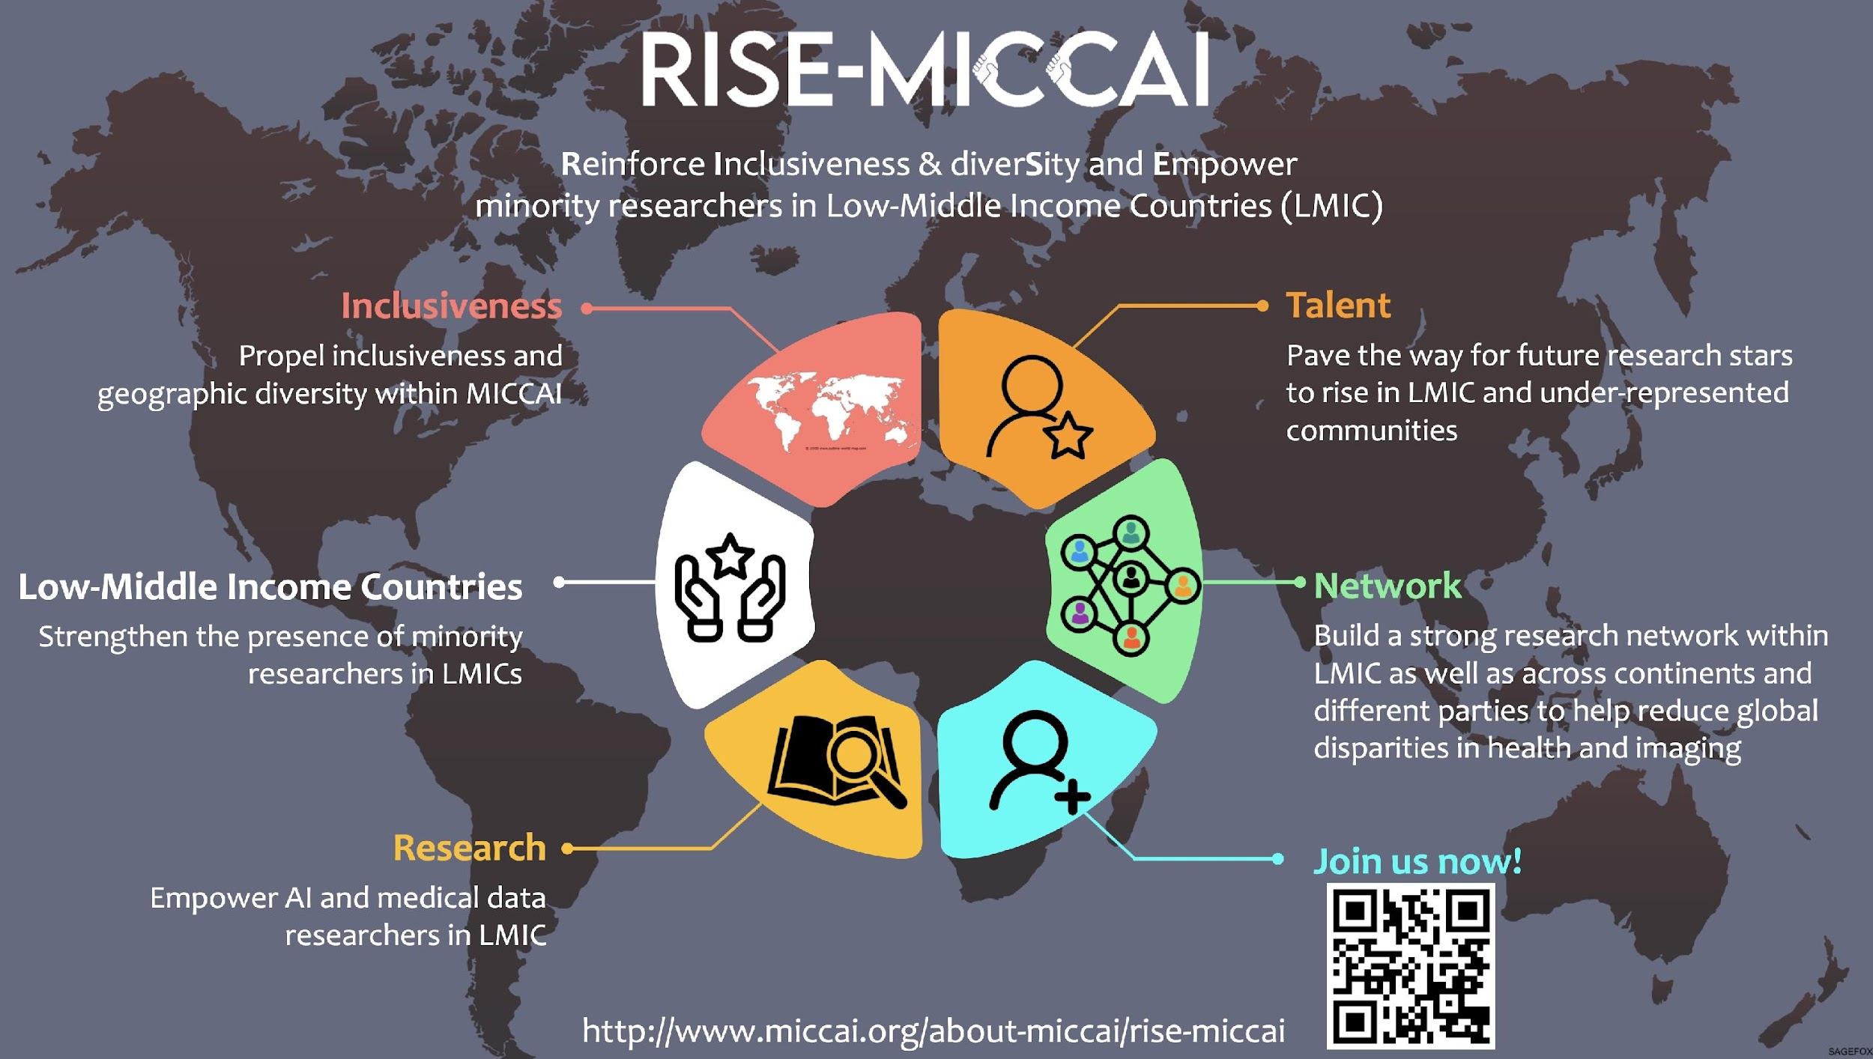

Slide 3
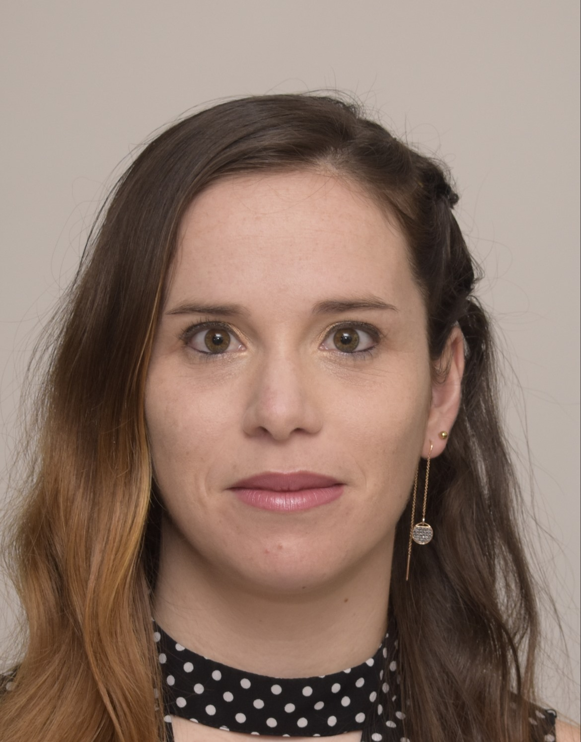
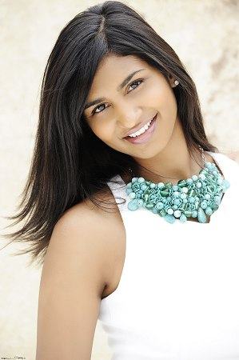
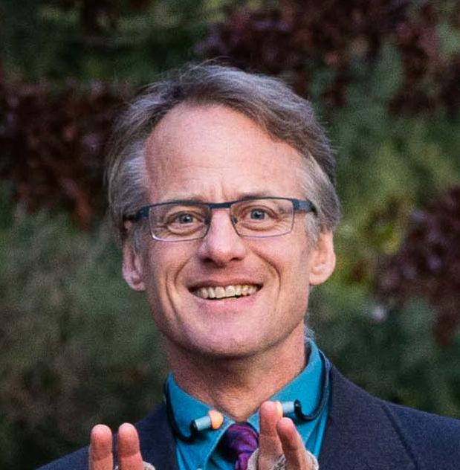

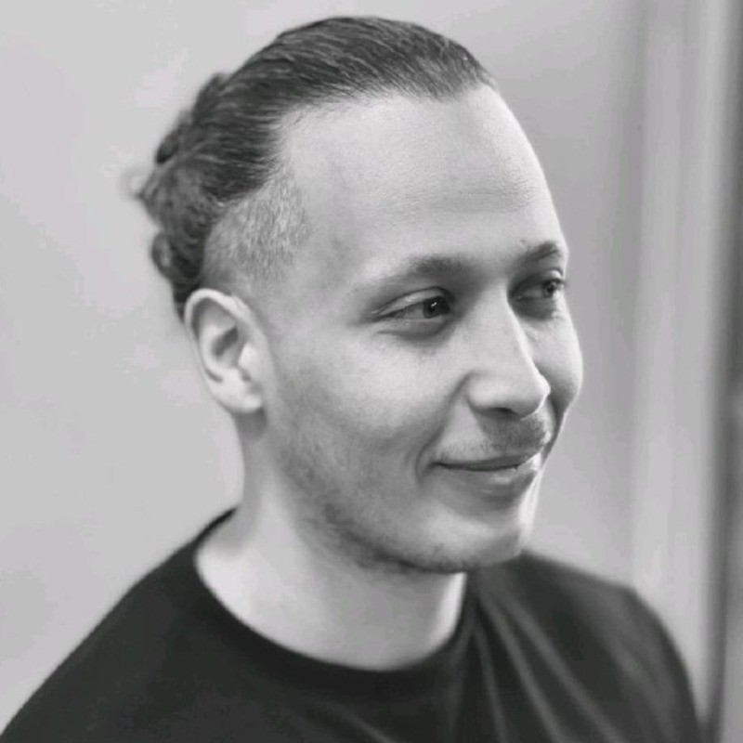

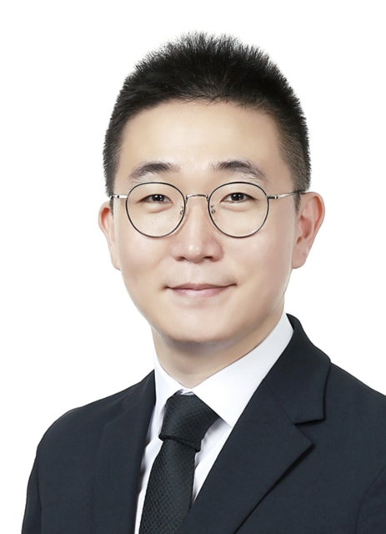
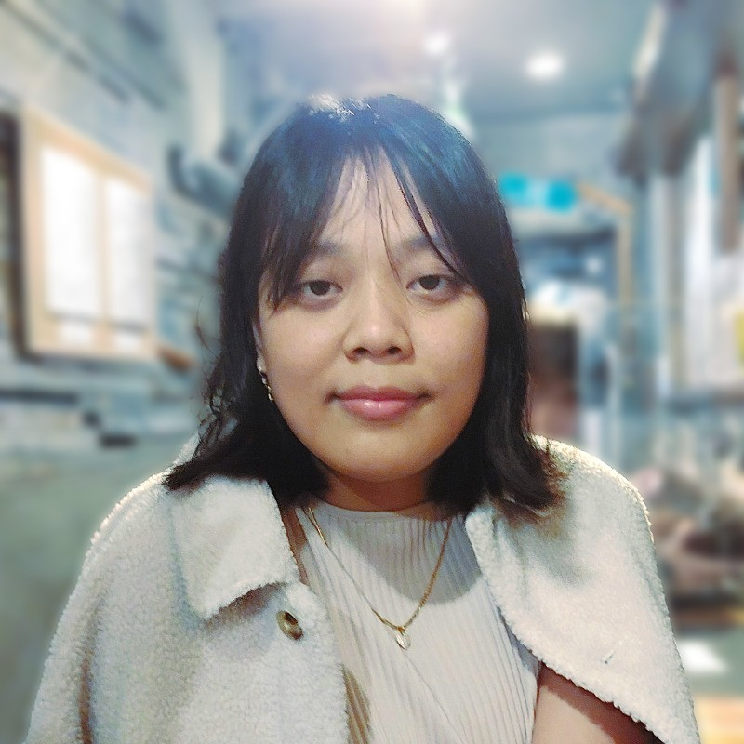
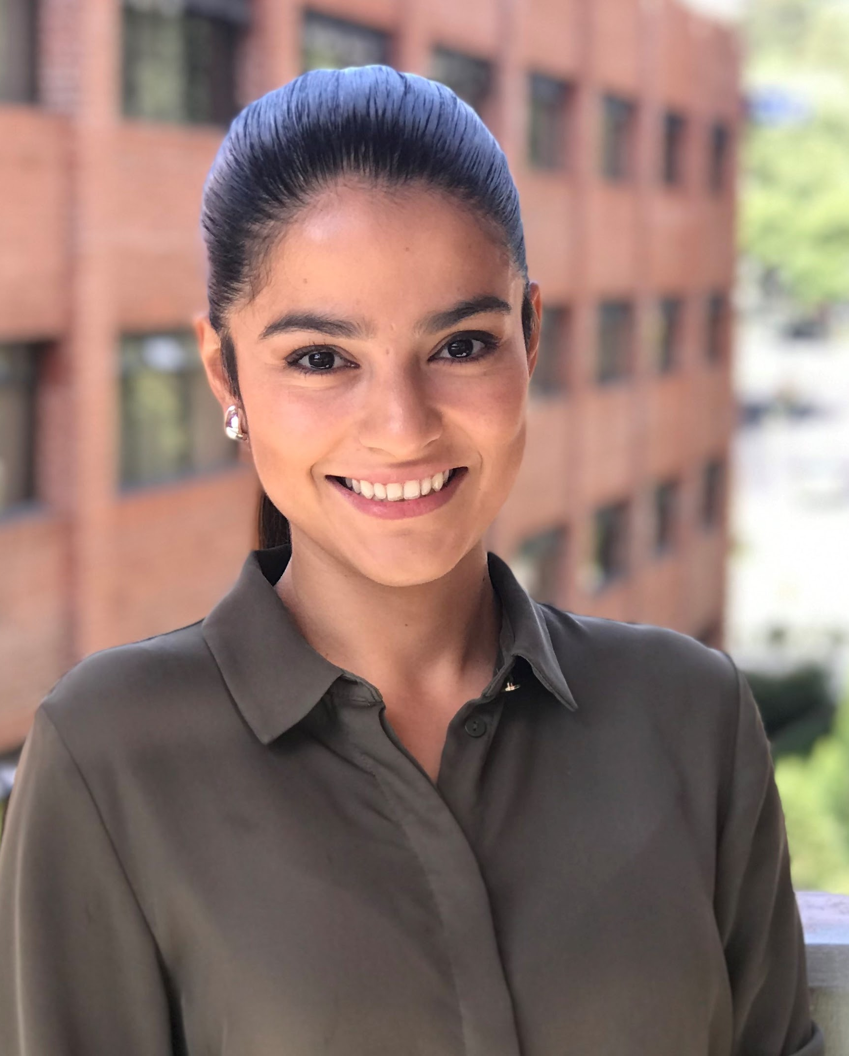
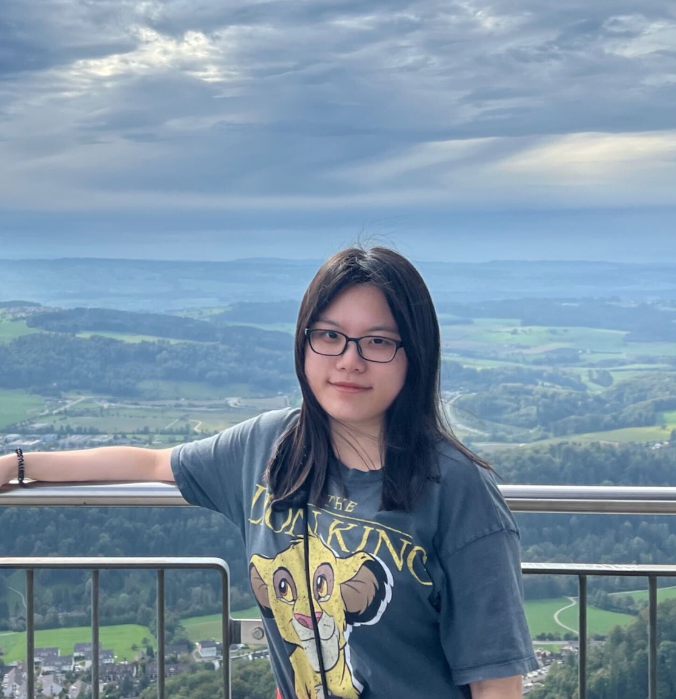
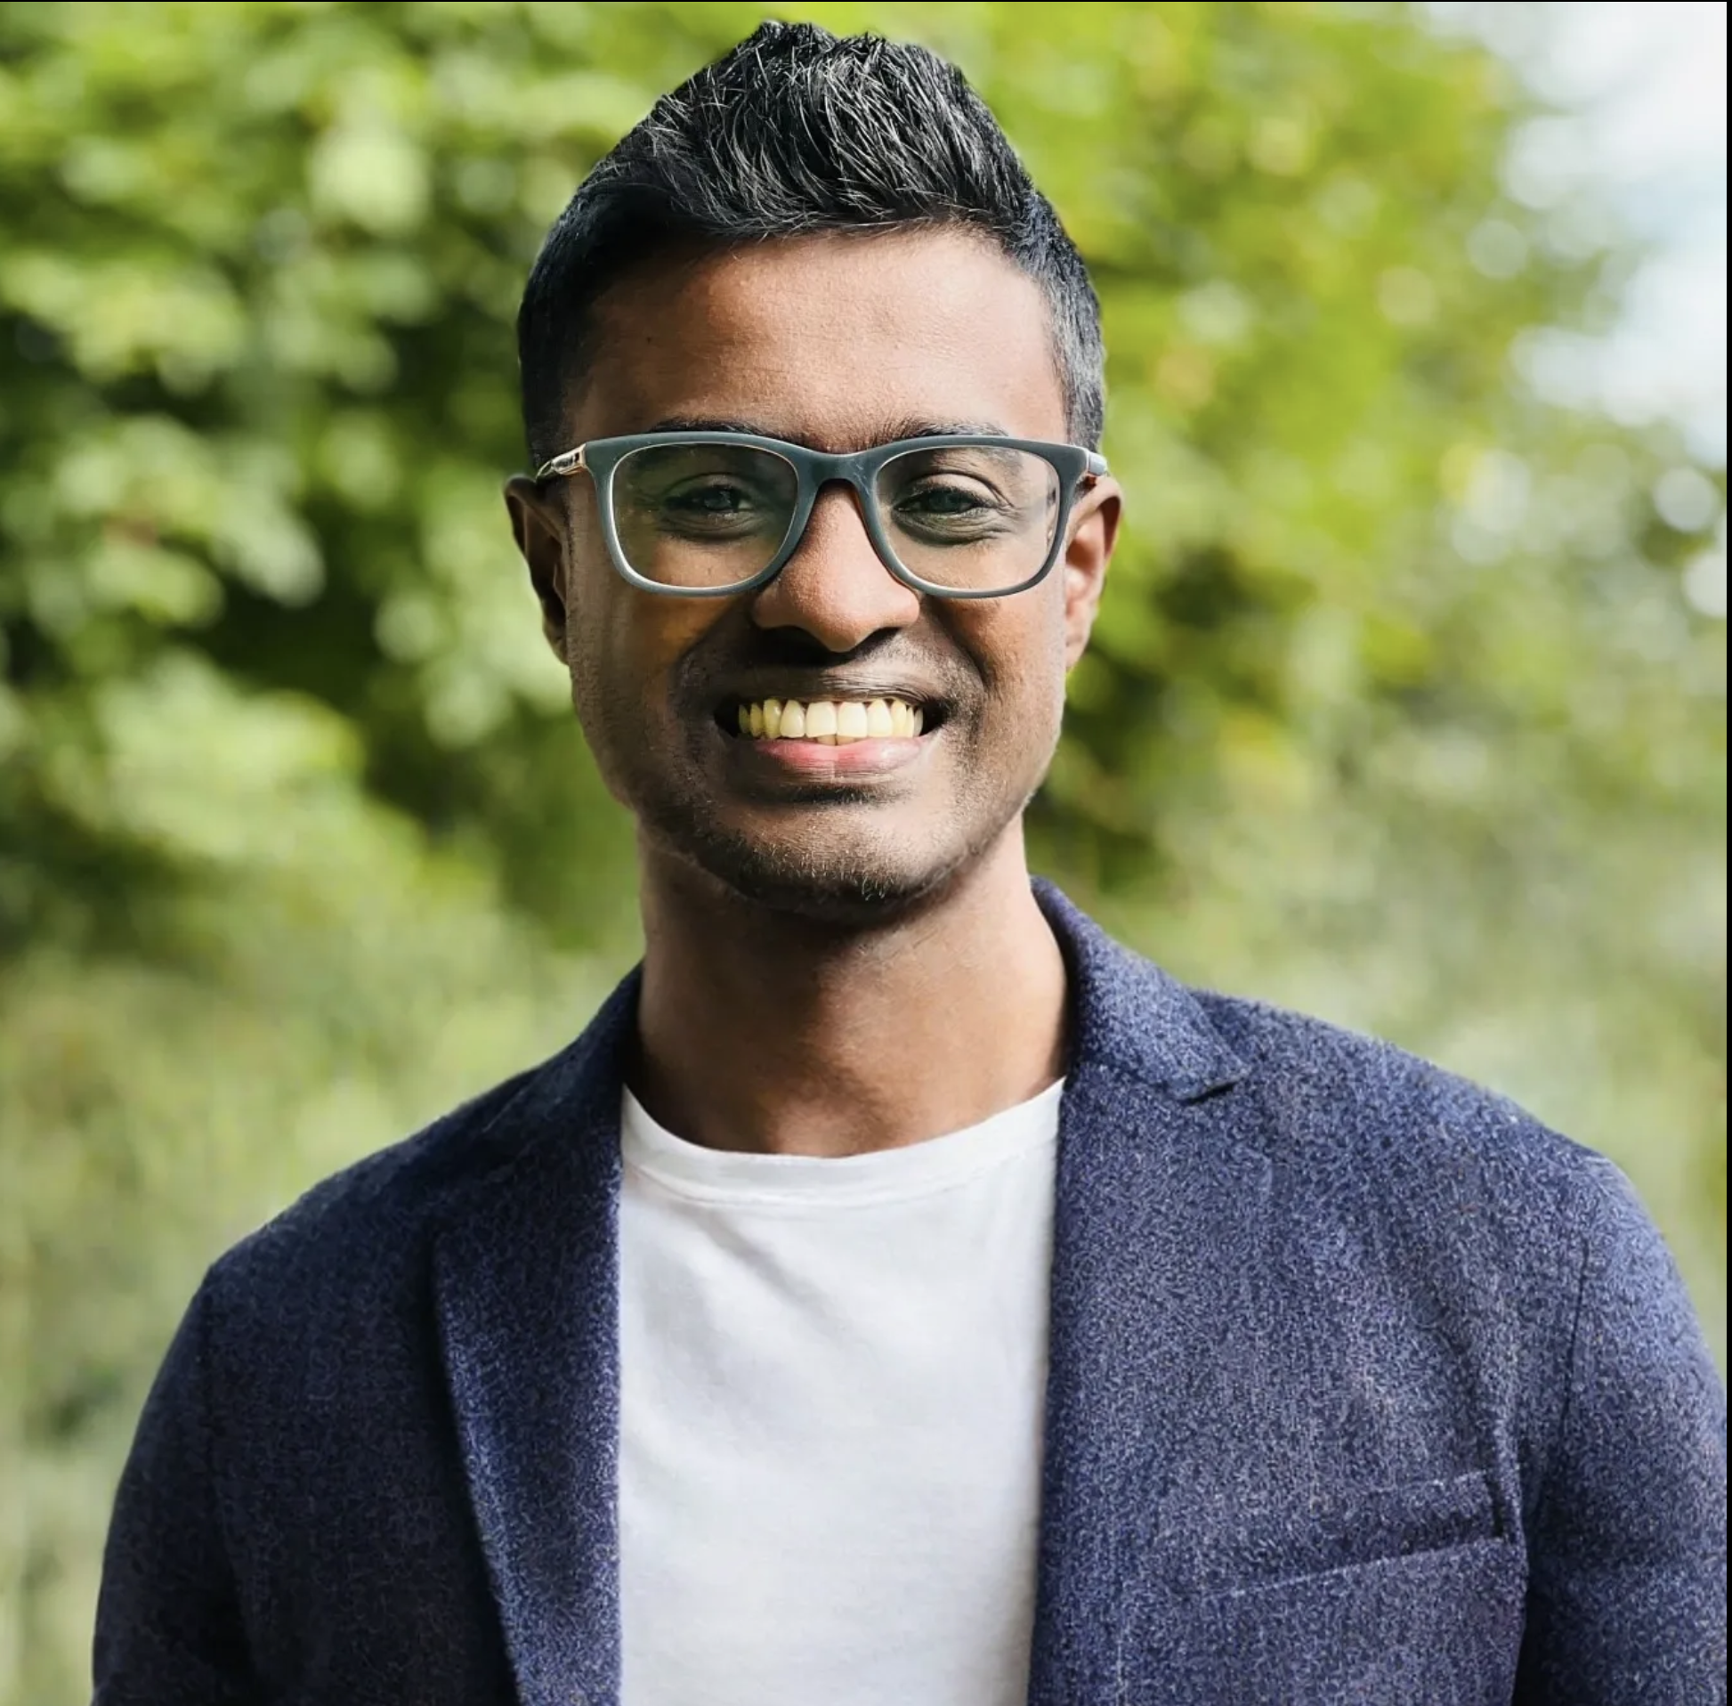
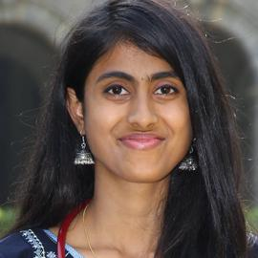
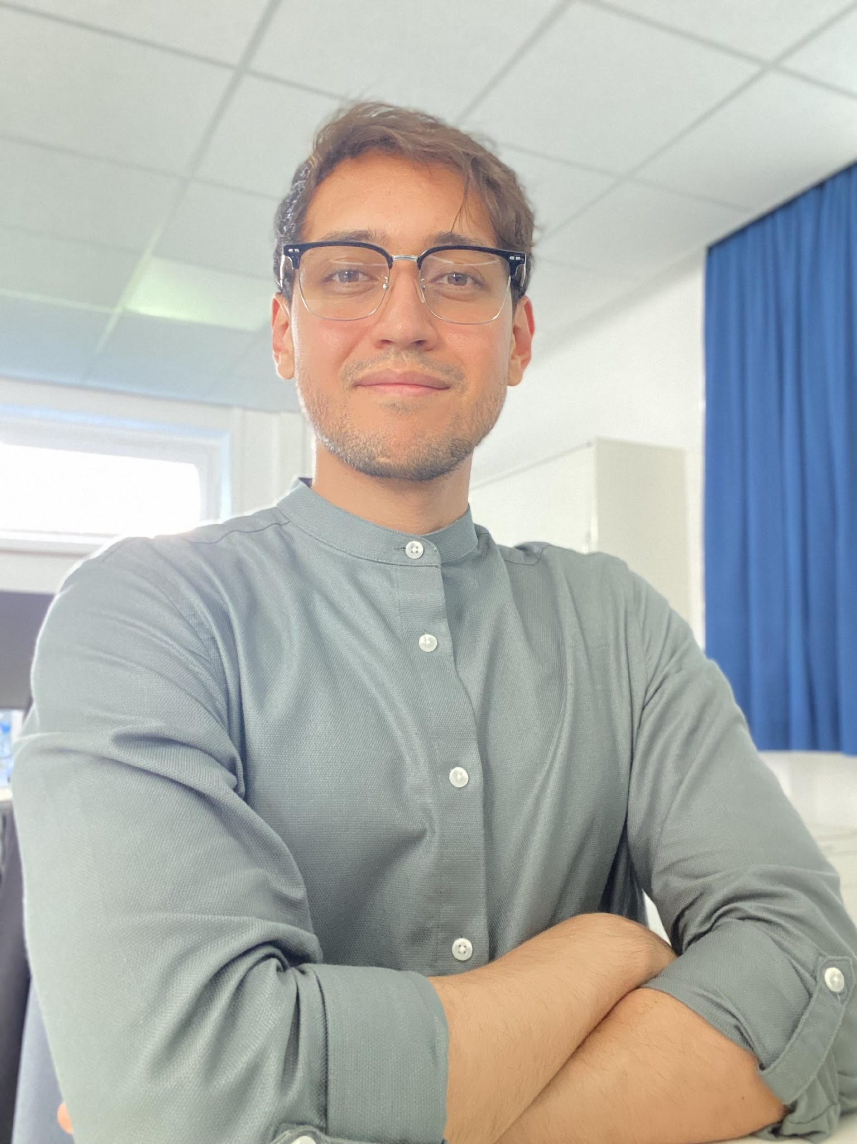
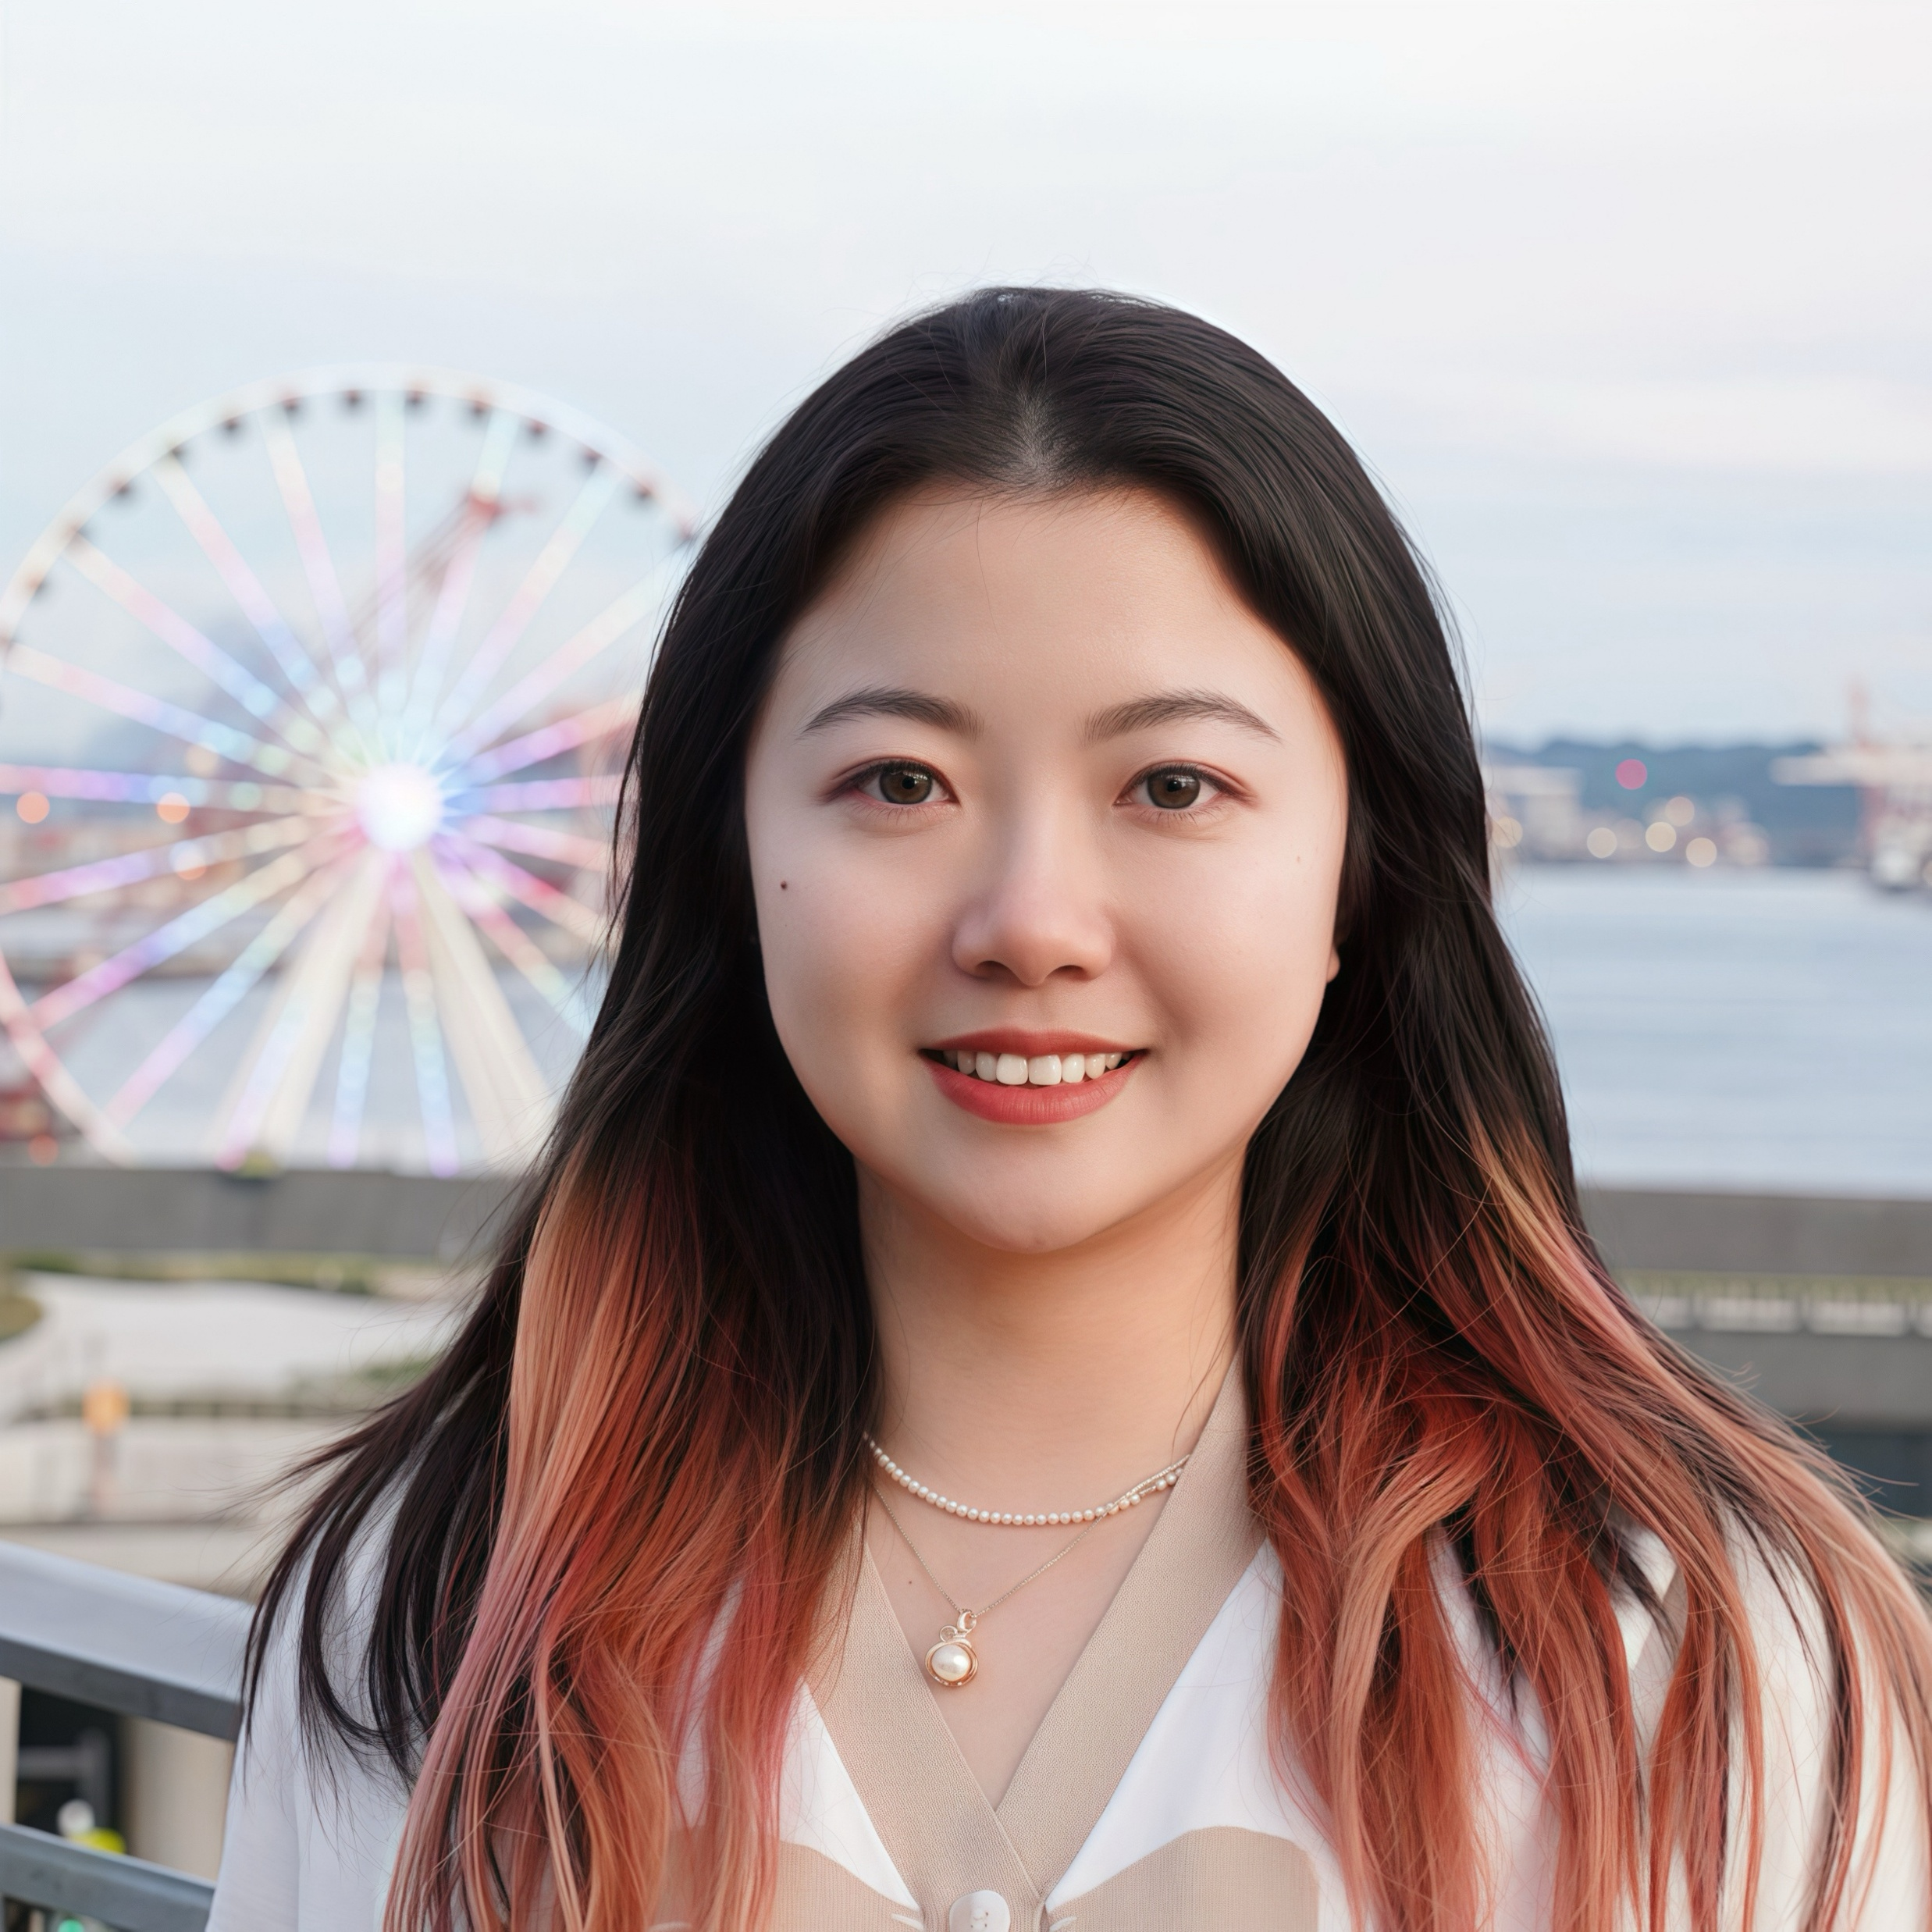
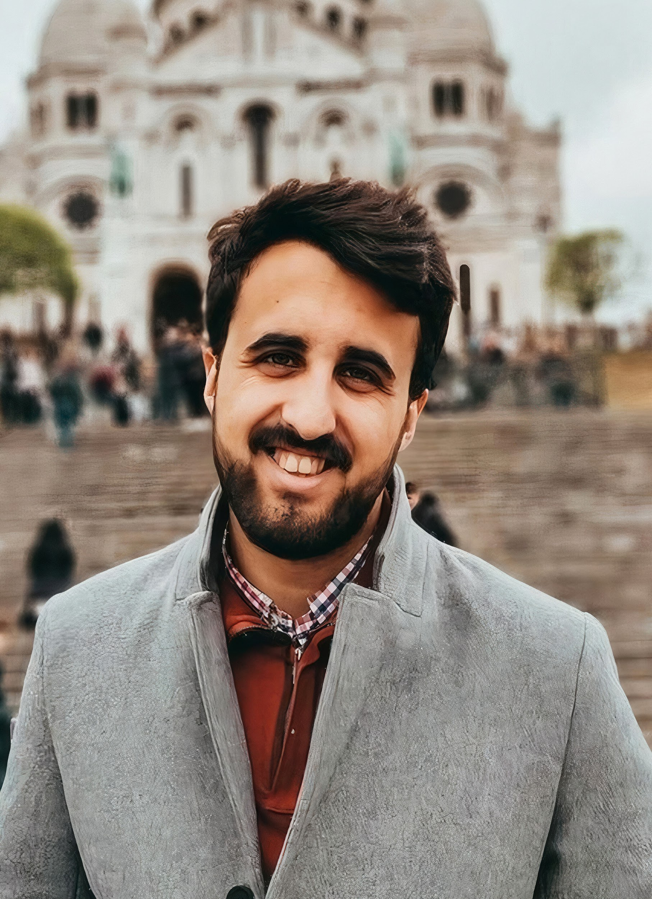

Board Members
President
President Assistant
Industry Liaisons
Tutorials Coordinator
Mentorship Coordinator
Website Coordinators
Esther Puyol
HeartFlow
Tareen Dawod
DTU Copenhagen
Charles Delahunt
Global Health Labs
Rabia Haq
3DR Labs
Rachid Zeghlache
IMT Atlantique
Omar Choudhry
University of Leeds
Jaeyoung Cho
University Hospital Vonn
Dewinda J. Rumala
Stanford University
Public Outreach
Storytelling Coordinators
School Coordinators
Journal Club Coordinator
Andrea Lara
Universidad Galileo
Nina Weng
DTU Copenhagen
Santosh Parampottupadam
German Cancer Research Center
Pooja Jain
Indian Institute of Technology Kharagpur
David Dueñas
University Hospital Bonn
Baoru Huang
Imperial College London
Alvaro Gonzalez-Jimenez
University of Basel
Pulkit Khandelwal
University of Pennsylvania
https://rise-miccai.org

Slide 4

RISE Community in Numbers
https://rise-miccai.org

Slide 5
Geolocating MICCAIers
Researchers of under-represented origins (Africa, Latin America, South/South-East Asian and Middle-East) who work in the field of Medical Image Computing and Computer-Aided Interventions (MICCAI) are barely represented in the community

Slide 6
1400+ RISE members
How many times have you attended the MICCAI conference?
Gender: how do you identify?
Ethnicity: how do you identify?
https://rise-miccai.org

Slide 7
RISE Events & Activities since MICCAI 2022

Slide 8
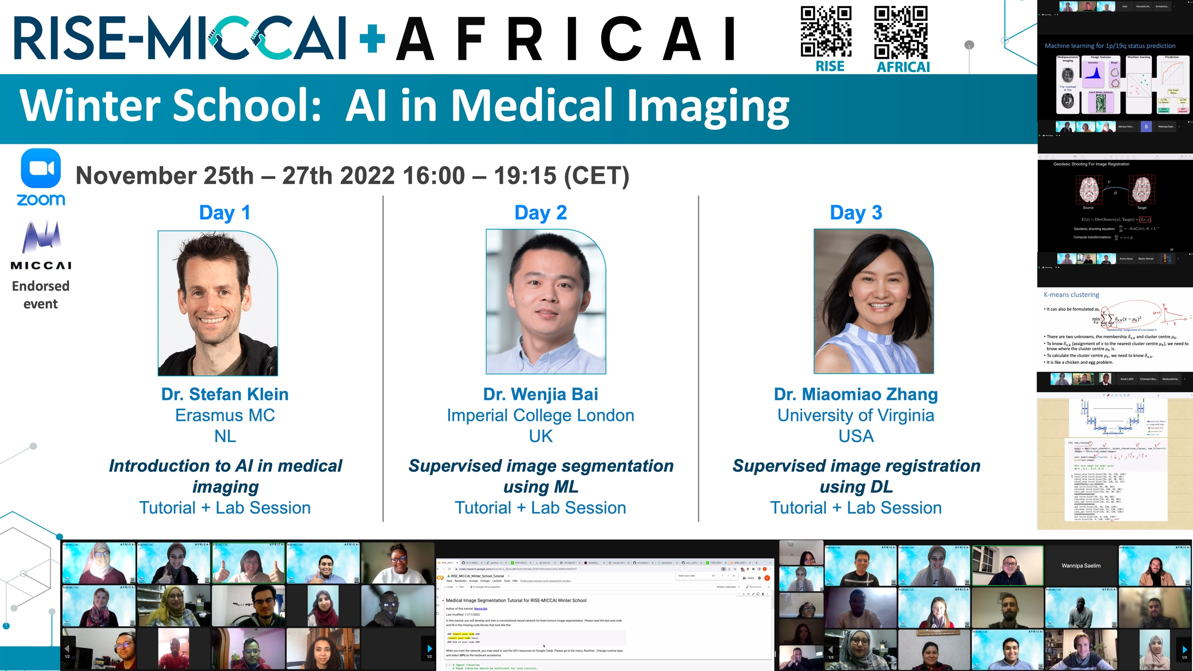

Slide 9
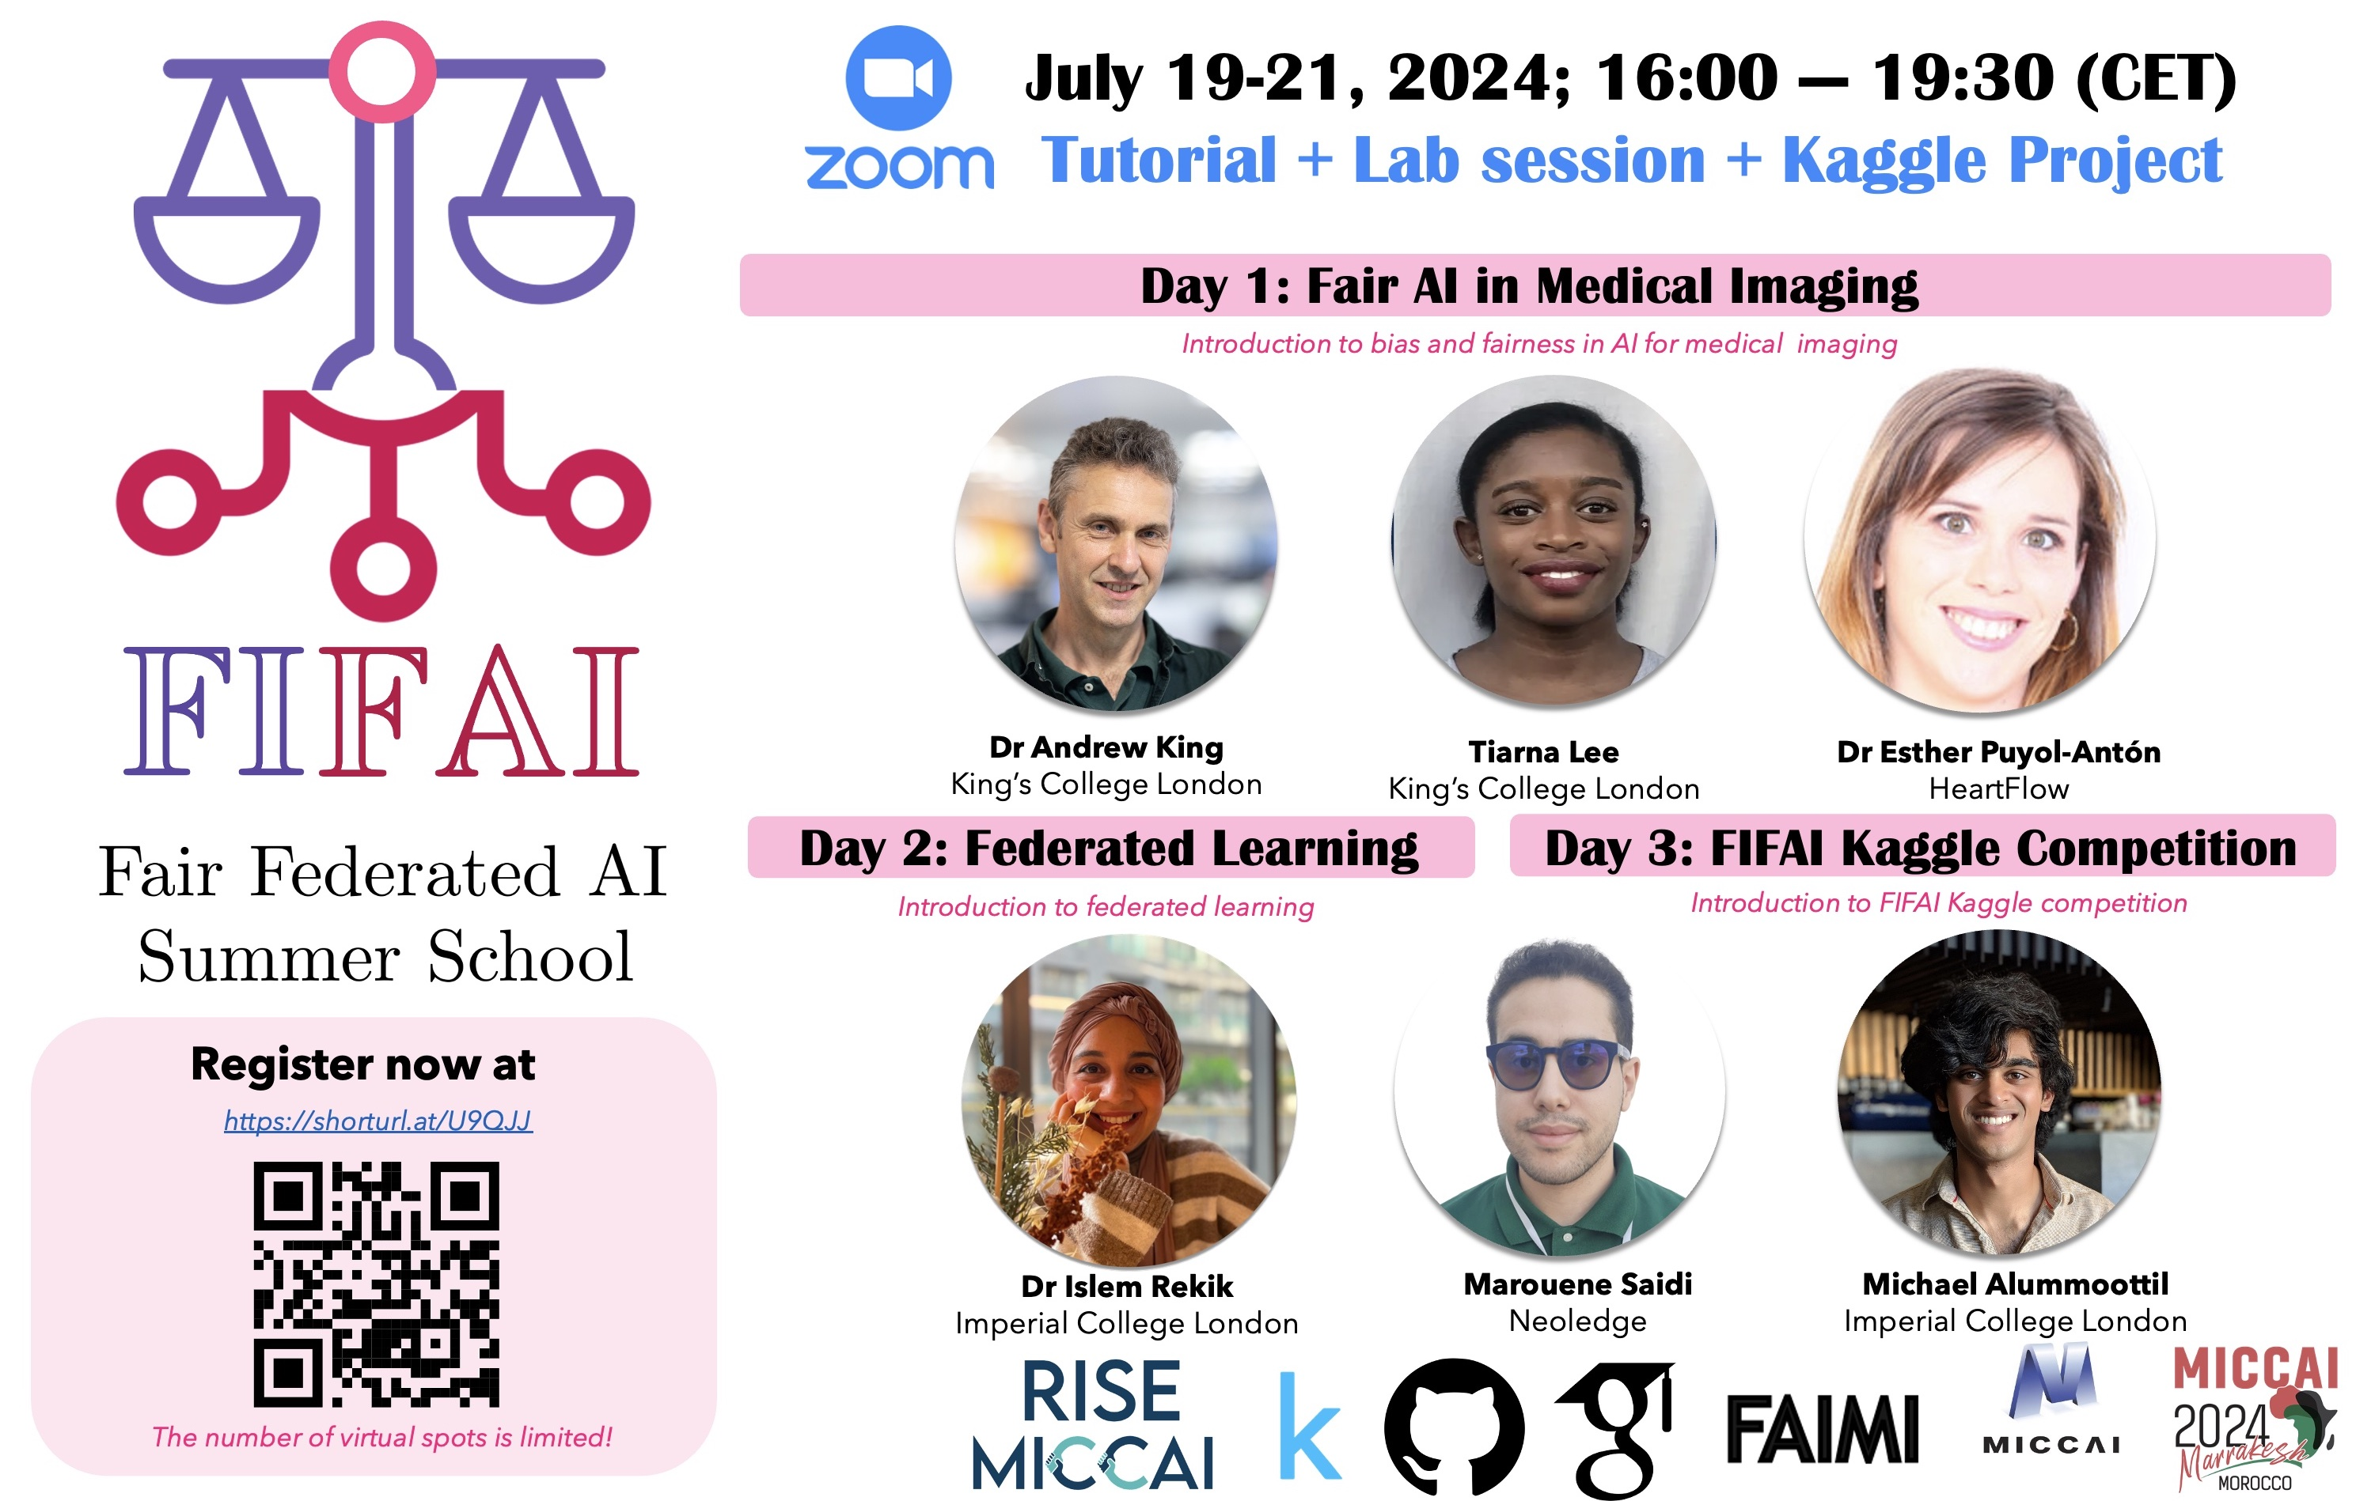
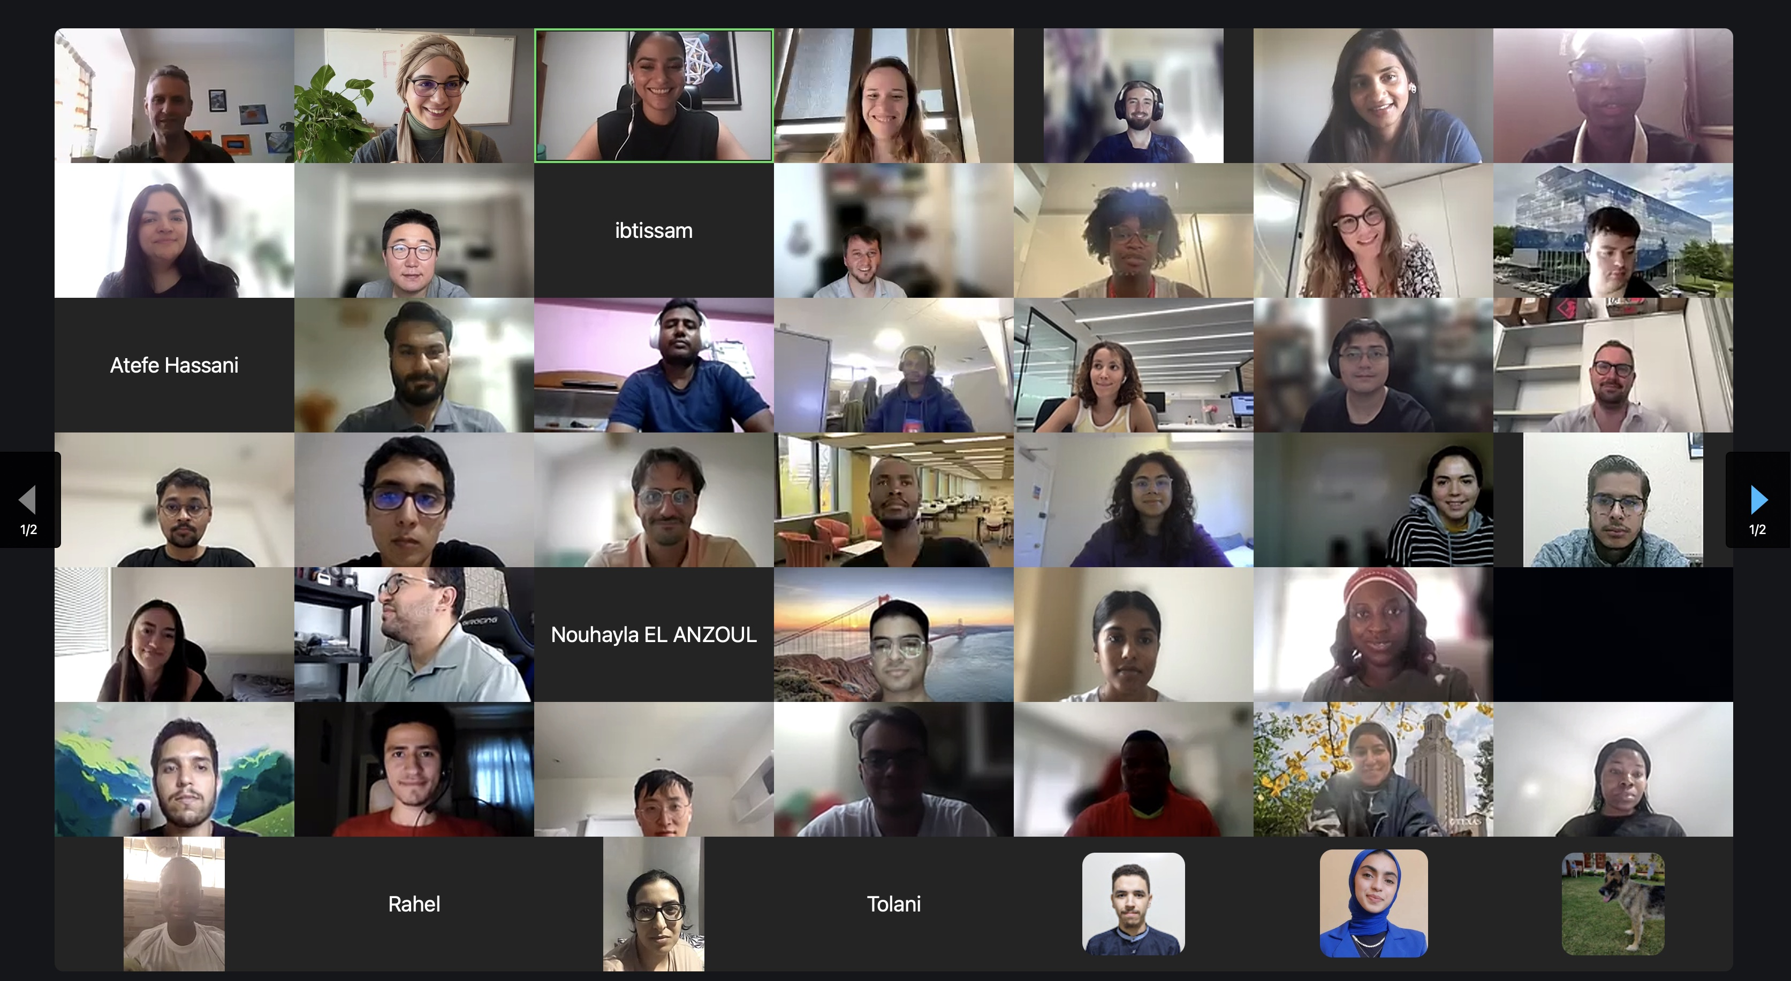
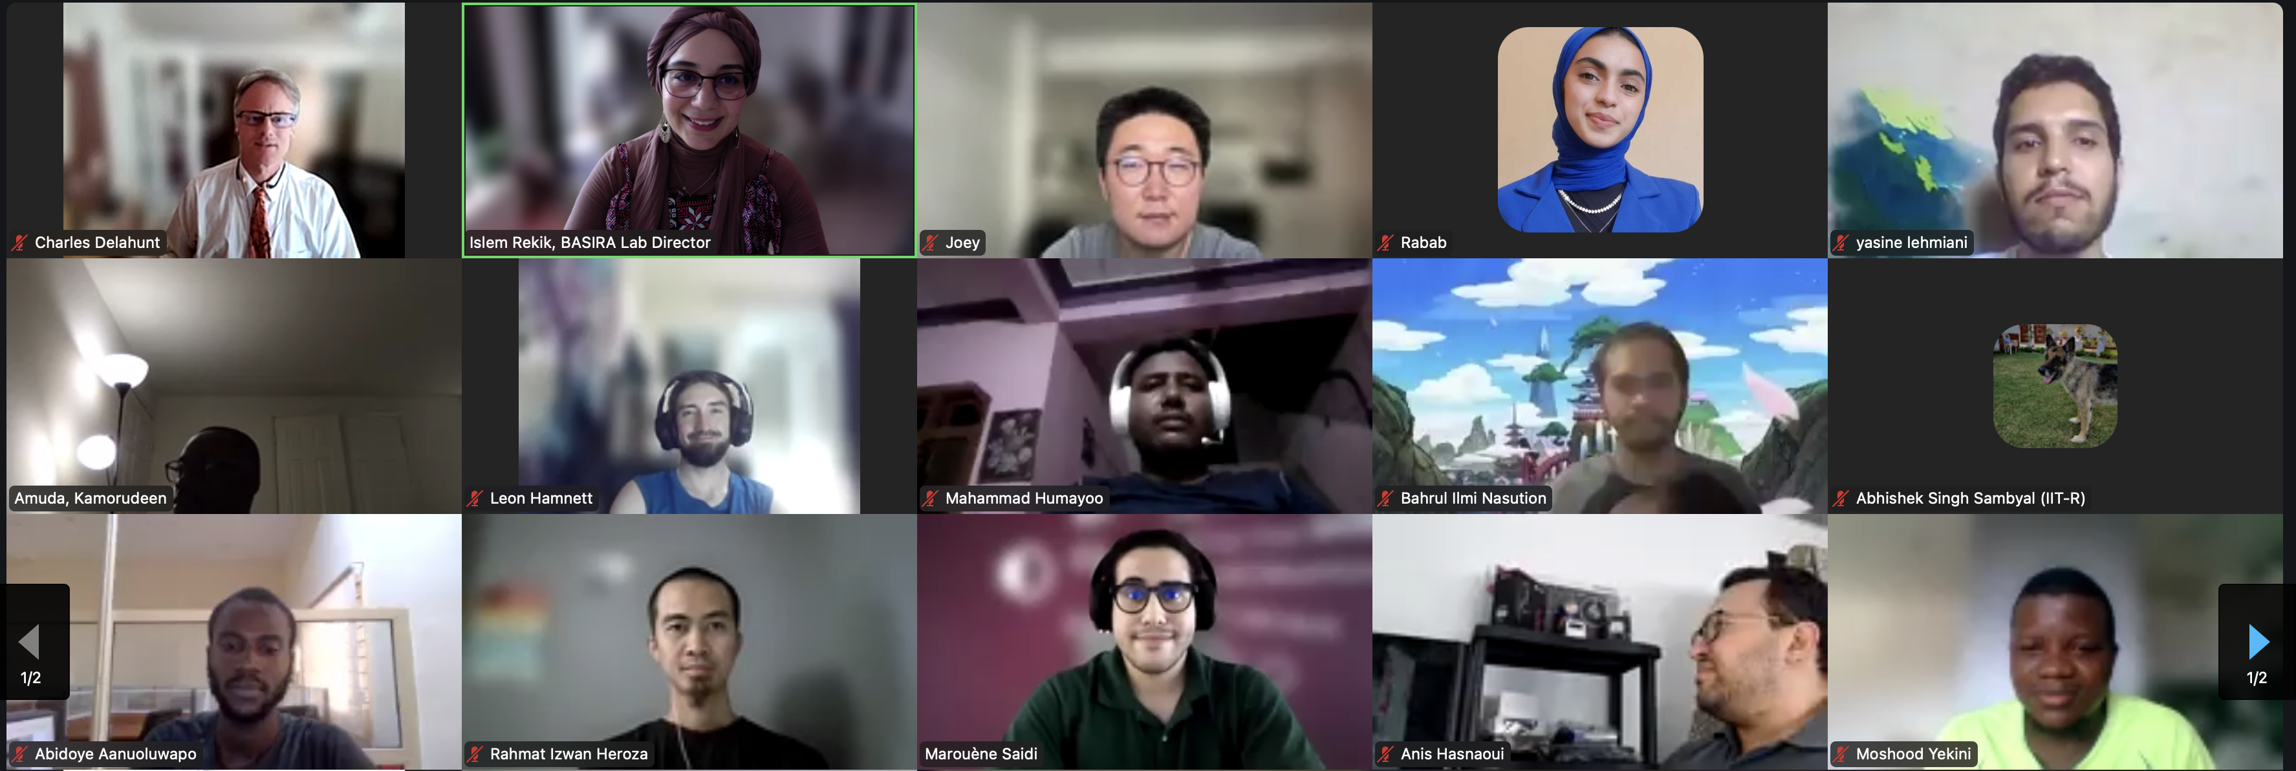
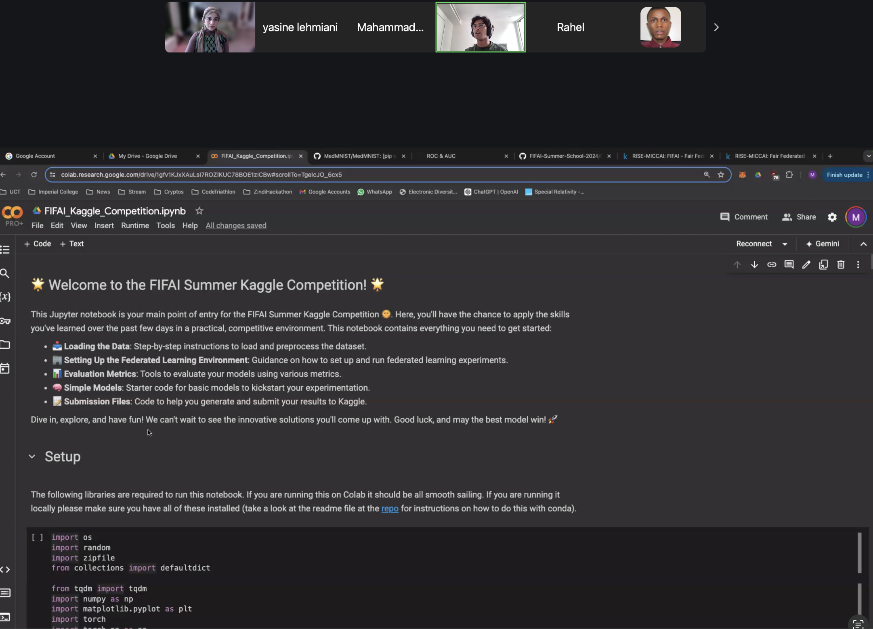
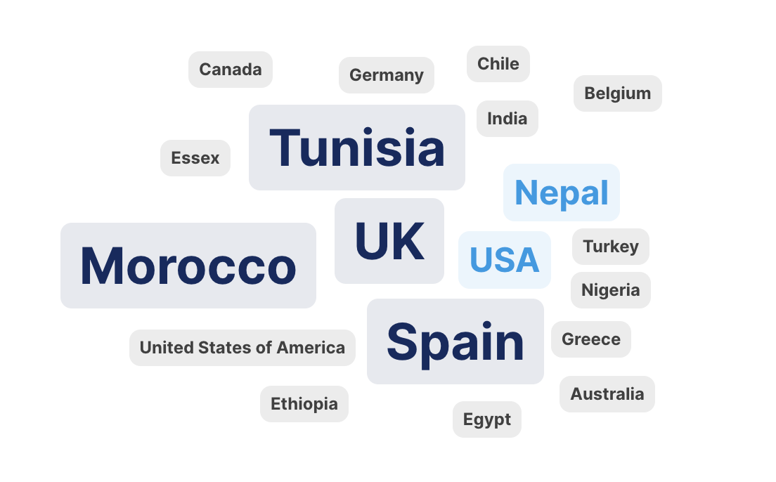
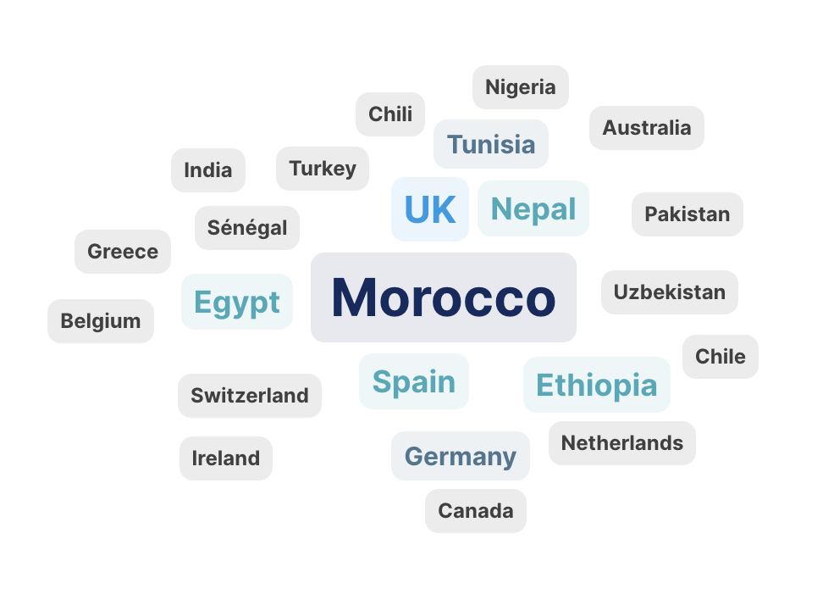
Day 1
Day 2
110+ global participants over 3 days
https://github.com/RISE-MICCAI/FIFAI-Summer-School-2024

Slide 10
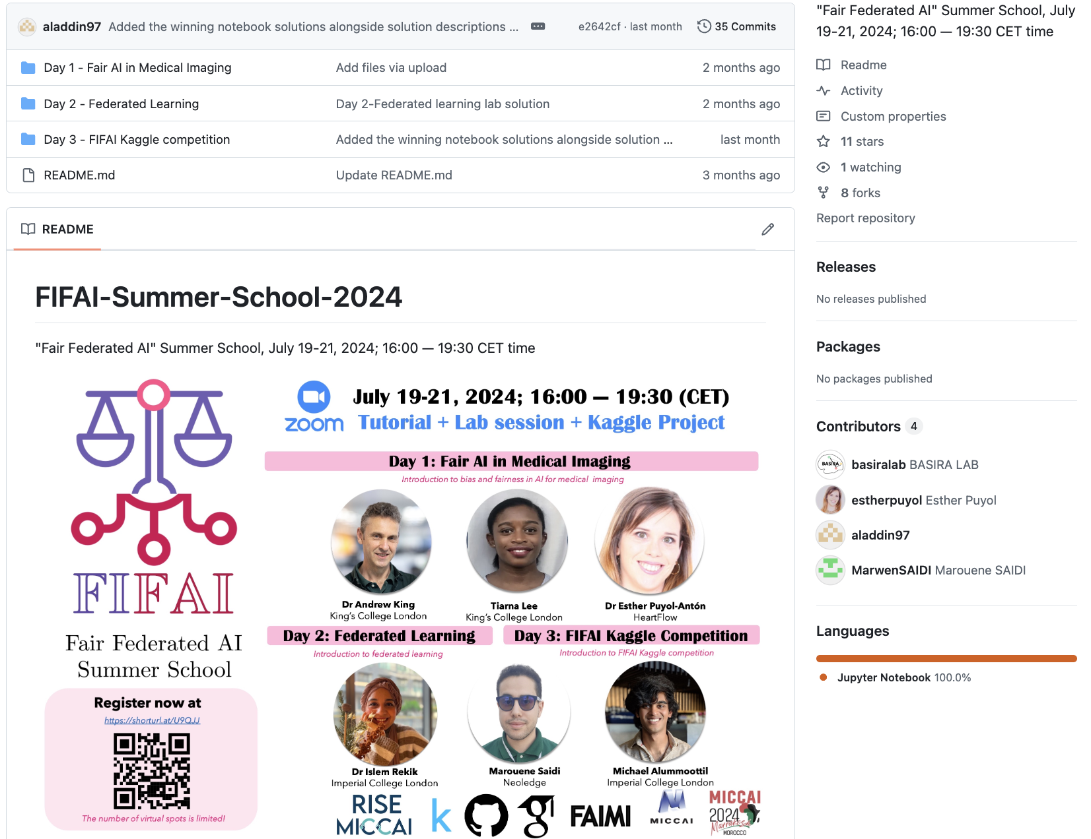
FIFAI Summer School
The RISE-MICCAI, jointly with the SIG-FAIMI network, has organized a Summer School in ”Fair Federated in Medical Imaging" featuring expert guest lecturers from prestigious international universities from July 19—21, 2024.
This event has been endorsed by the MICCAI Society.
We had 110+ diverse attendees joining from different continents including under-represented countries in Africa, Latin America and South Easter Asia.
The sessions were vibrant and highly interactive. We also had Jupyter notebook lab sessions led by our fantastic volunteers.
First Kaggle competition on Fair Federated AI

Slide 11
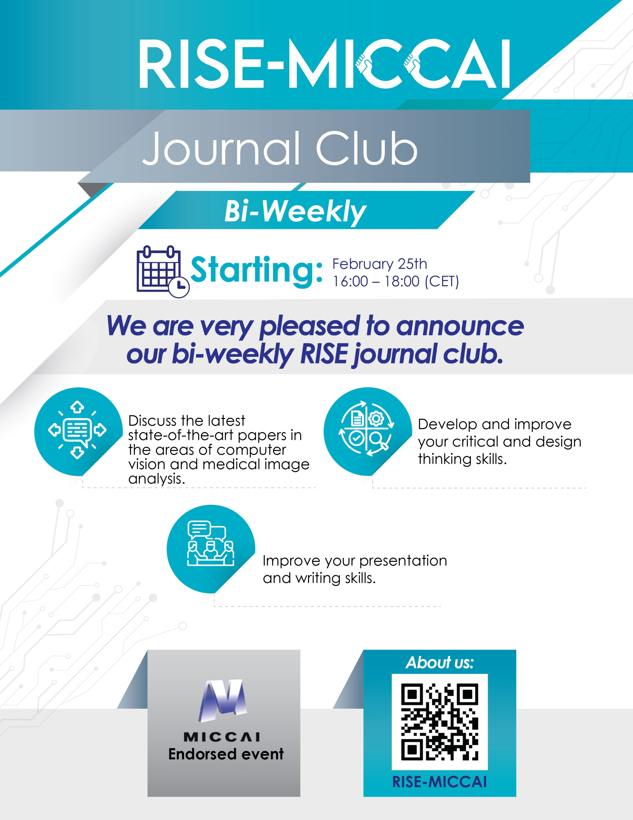
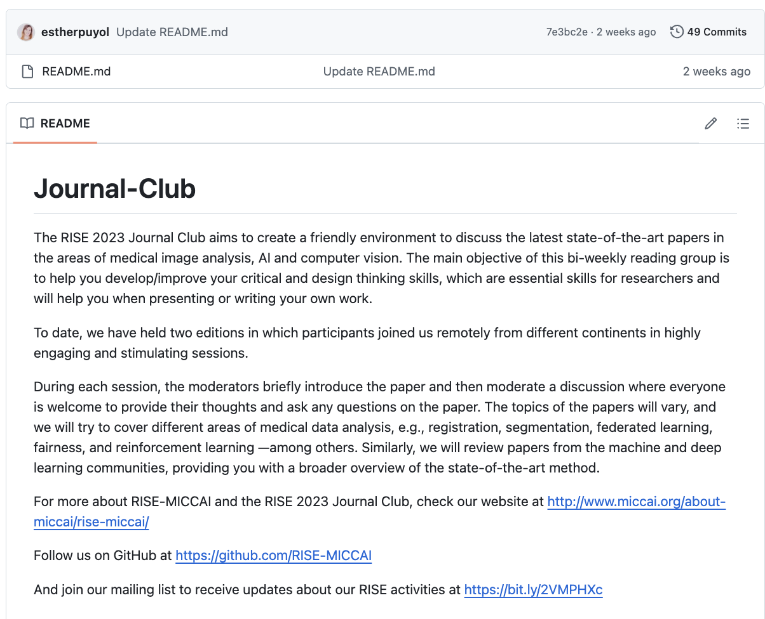
RISE Journal Club Coordinators
Alvaro Gonzalez-Jimenez
University of Basel
Pulkit Khandelwal
University of Pennsylvania
https://rise-miccai.org/publication/

Slide 12
RISE-MICCAI launched the RISE Journal Club, which creates a friendly environment to discuss the latest high-quality papers in machine learning, computer vision and medical image analysis.
Since spring 2023, 54 fortnight sessions.
40 invited moderators from the MICCAI Society have presented on the RISE journal club.
We had 50+ diverse attendees joining from different continents including under-represented countries in Africa, Latin America and South Easter Asia.
During the journal club sessions, young researchers engage actively on the discussion of the papers, and we encourage them to improve their critical and design thinking skills.
We always seek for more volunteers to host the sessions.
Latest session available in YouTube
https://rise-miccai.org/publication/

Slide 13
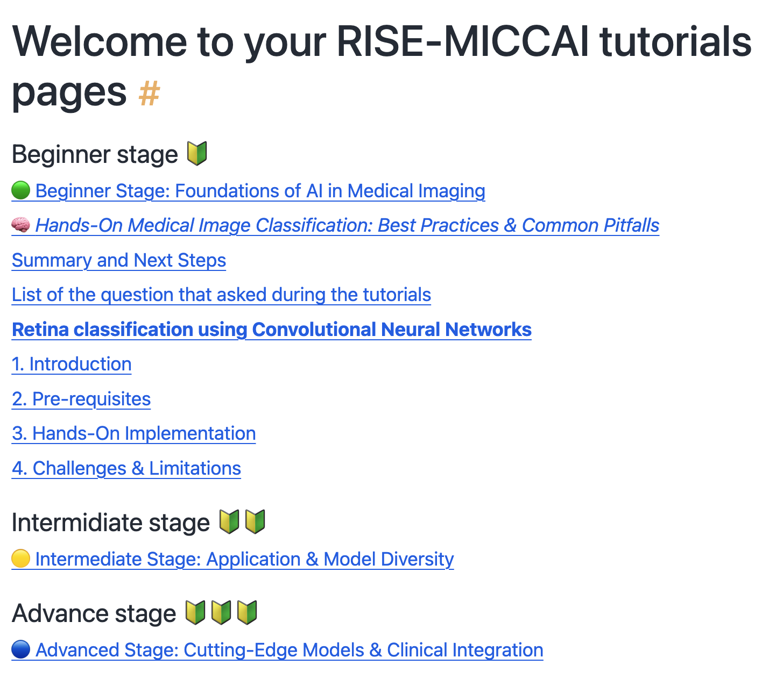
RISE Tutorials
RISE-MICCAI Tutorials bring you monthly deep dives into Computer Vision & Medical Image Analysis.
Our sessions are designed to provide thorough theoretical foundations, share real-world applications, and offer valuable research insights to support the community's learning journey.
Since Spring 2025, we've hosted 4 engaging monthly sessions, welcoming over 40 diverse attendees from across continents, including participants from under-represented countries in Africa, Latin America, and South-East Asia.
Latest session available in YouTube
https://rise-miccai.org/publication/

Slide 14
RISE Events at MICCAI

Slide 15
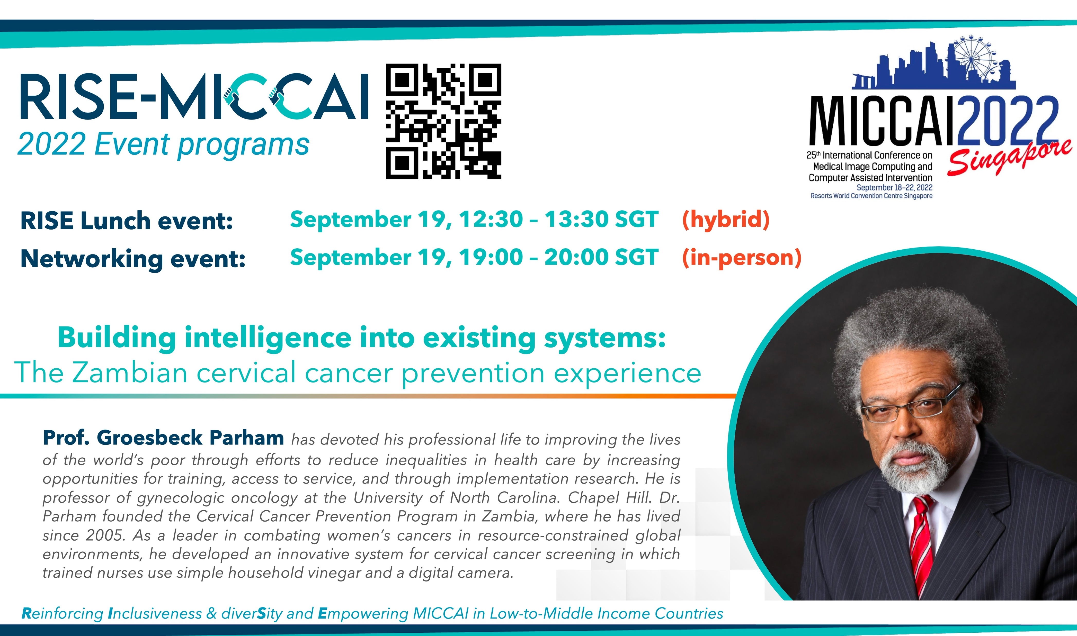

Slide 16




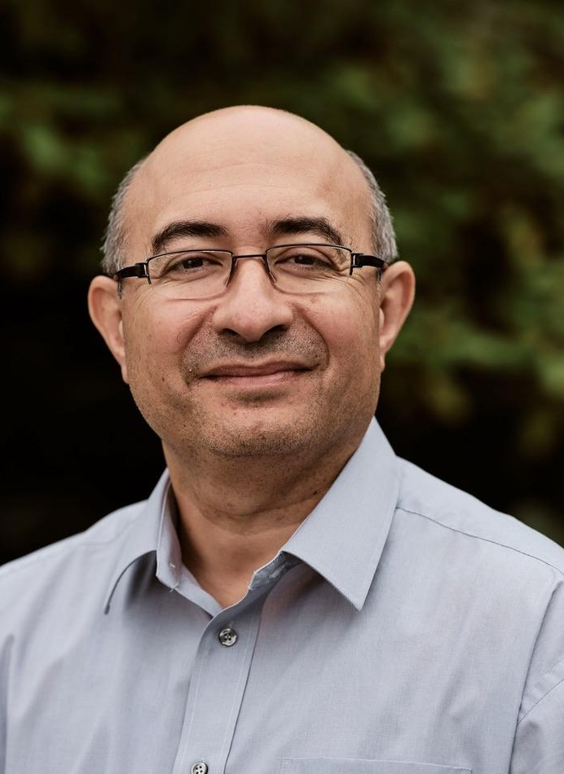
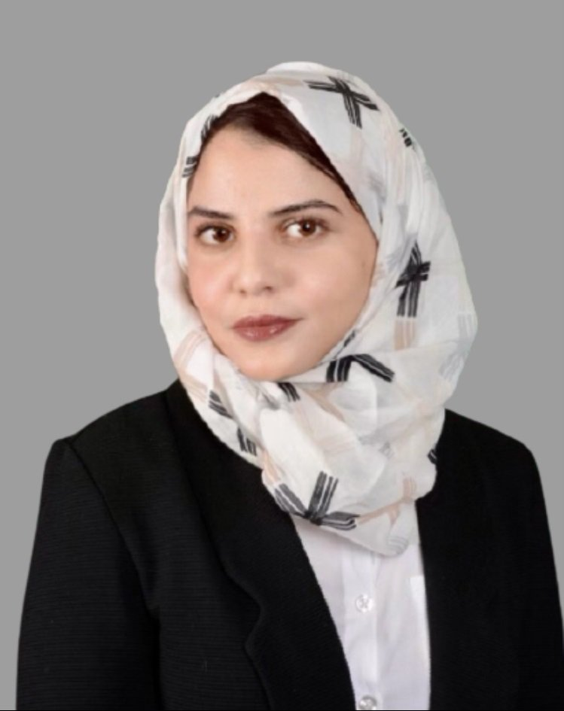
2023 Event program
RISE Lunch event:
October 11, 12:00 – 13:00
Rising from the Pandemic: Towards Sustainable Development of Machine Learning Technologies for Point of Care Ultrasound Imaging
Prof. Purang Abolmaesumi is internationally recognized and has received numerous awards for his pioneering developments in medical image analysis and image-guided interventions. Dr. Abolmaesumi carries out research in medical imaging, machine learning, and image-guided diagnosis and interventions. Dr. Abolmaesumi is a Canada Research Chair, Tier II, in Biomedical Engineering and Professor, with Associate Memberships to Department of Urologic Sciences and School of Biomedical Engineering at UBC.
The RISE of Democratized Echocardiography Through AI Technologies
Dr. Ghada Zamzmi currently serves as a staff scientist at the Office of Science and Engineering Laboratories (OSEL) within the FDA's Center for Devices and Radiological Health (CDRH). As a dedicated global scholar, Ghada actively collaborates with peers across continents and has played a key role in organizing workshops and challenges at top venues such as CVPR, NeurIPS, MICCAI, and ICML. Committed to empowering women in STEM, she has actively participated in organizations such as Women in AI, Women in Computer Vision, and Women in MICCAI.

Slide 17


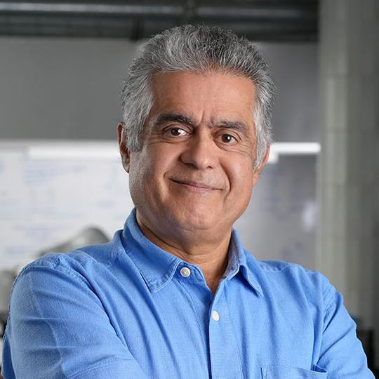
2024 Event program
RISE Lunch event: October 9, 12:00 pm
Towards the democratization of healthcare:
the scientific path of an ‘illegal’ immigrant
Prof. Nassir Navab is a full professor and director of the Laboratories for Computer Aided Medical Procedures at Technical University of Munich (TUM). He is also the director of Medical Augmented Reality summer school series. He is a Member of Academia Europaea and received the prestigious MICCAI Enduring Impact Award in 2021 and IEEE ISMAR 10 Years Lasting Impact Award in 2015. In 2001, while acting as distinguished member of technical staff at Siemens Corporate Research (SCR) in Princeton, he received the prestigious Siemens Inventor of the Year Award for the body of his work in interventional imaging. He also received the SMIT Technology Innovation Award in 2010. He is recently honored as Medical AR Pioneer in AWE XR hall of fame
He is also recognized for his pioneering work on digital surgical workflow modeling and representation starting in 2005 and on robotic imaging starting in 2012. His students have received many paper awards including 15 awards at the prestigious MICCAI events, 8 at IPCAI, 2 at IPMI and 4 at IEEE ISMAR. He is Fellow of the MICCAI Society and acted on its board of directors from 2007 to 2012 and from 2014 to 2017. He is also an IEEE Fellow, Fellow of International Academy of Medical and Biological Engineering (IAMBE), and Fellow of Asia-Pacific Artificial Intelligence Association (AAIA) and one of the founders of IEEE Symposium on Mixed and Augmented Reality (ISMAR) and has been serving on its Steering Committee since 2001. He is the author of hundreds of peer reviewed scientific papers and over 100 granted US and international patents. As of August 2024, his papers have received over 81400 citations and enjoy an h-index of 122.
More about RISE MICCAI:
http://www.miccai.org/about-miccai/rise-miccai/
https://github.com/RISE-MICCAI/

Slide 18
RISE Summer School 2025

Slide 19
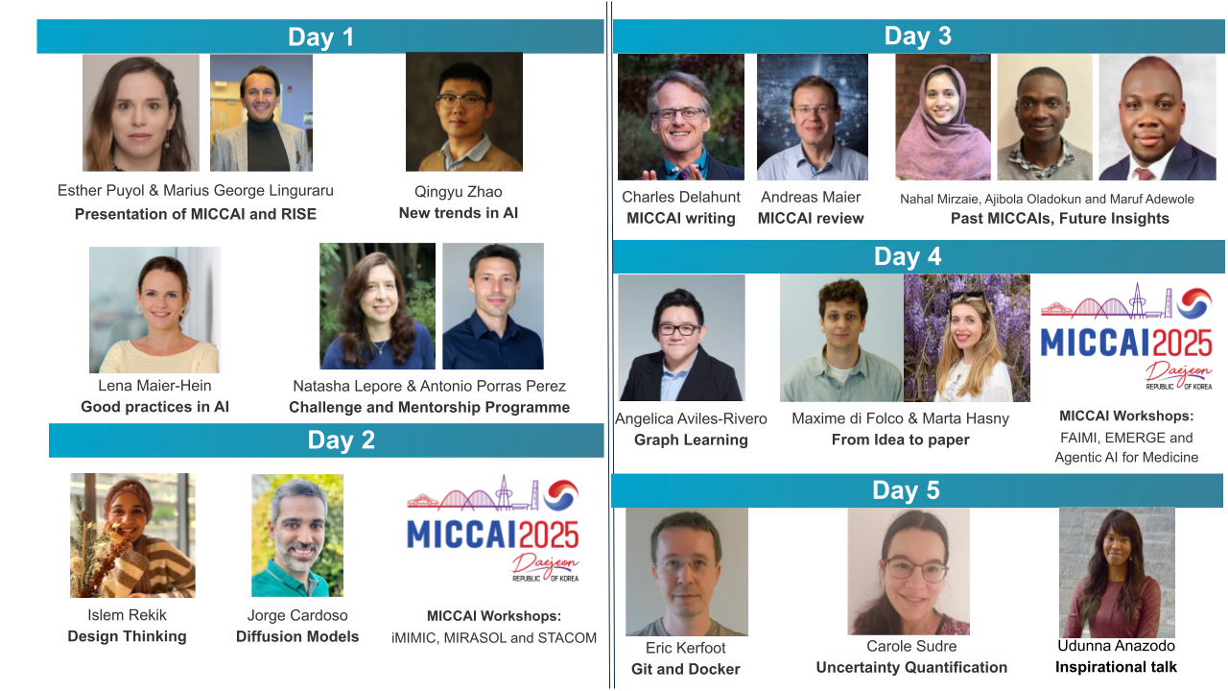

Slide 20
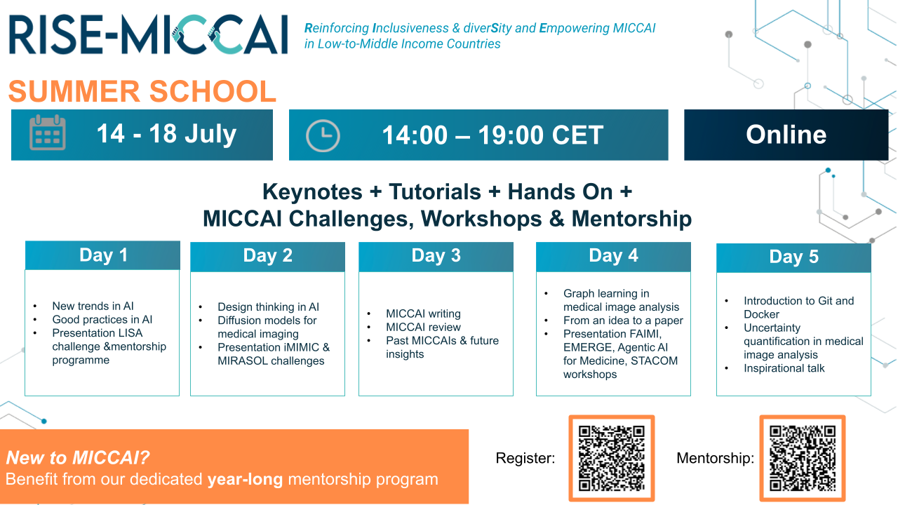

Slide 21


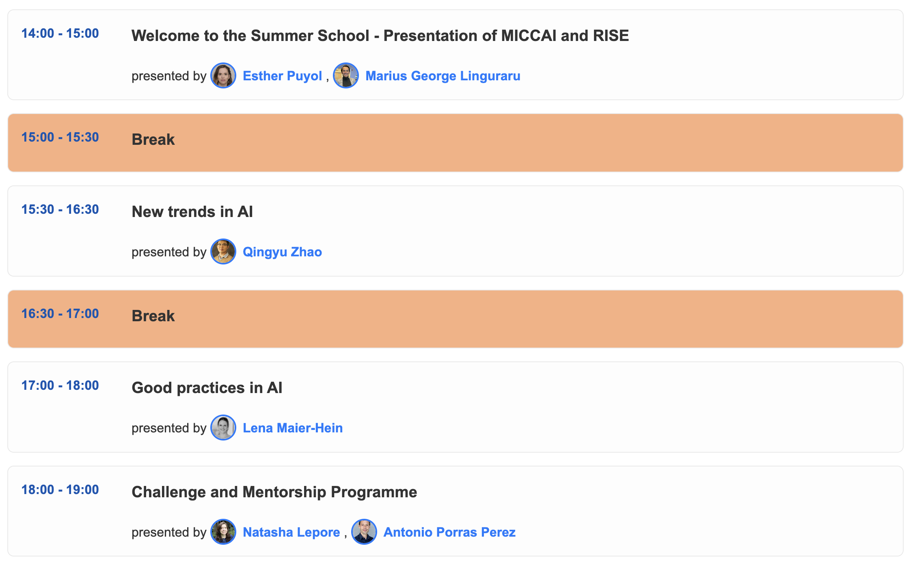
Day 1
https://summer.rise-miccai.org/

Slide 22
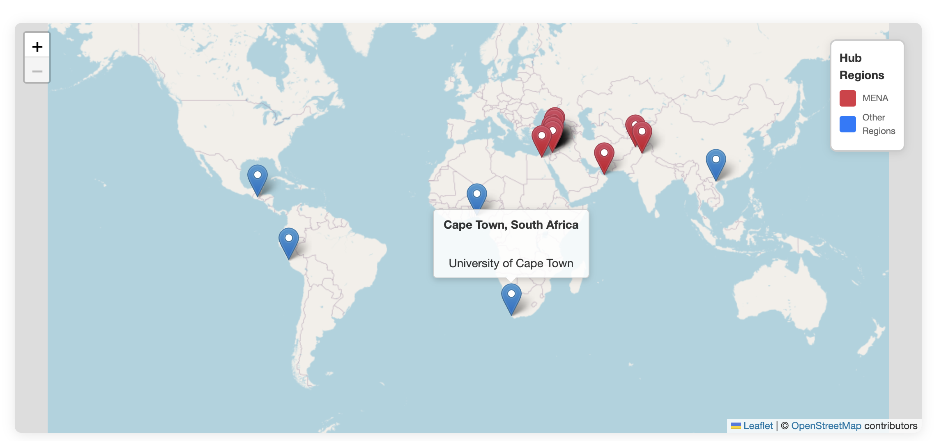
Local Hub Locations
https://summer.rise-miccai.org/

Slide 23
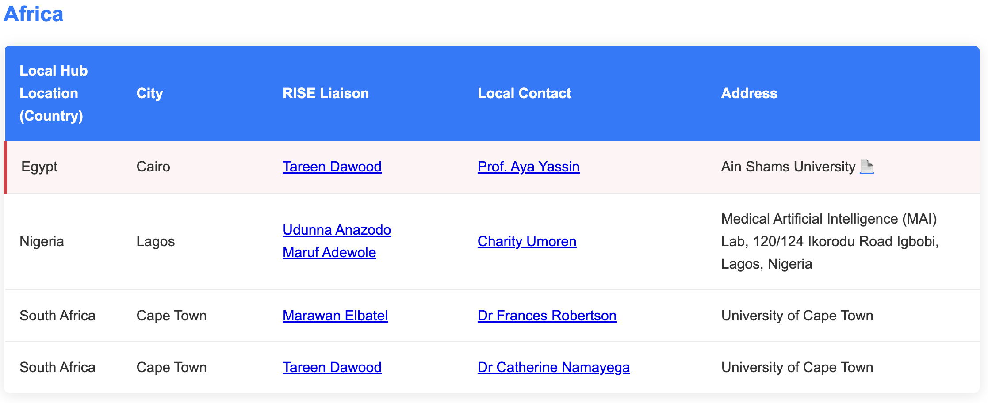
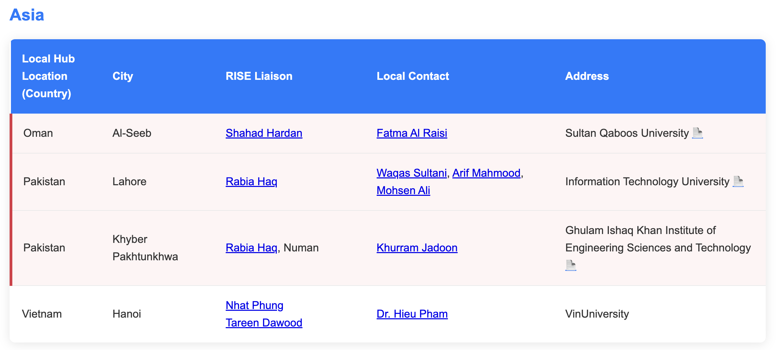
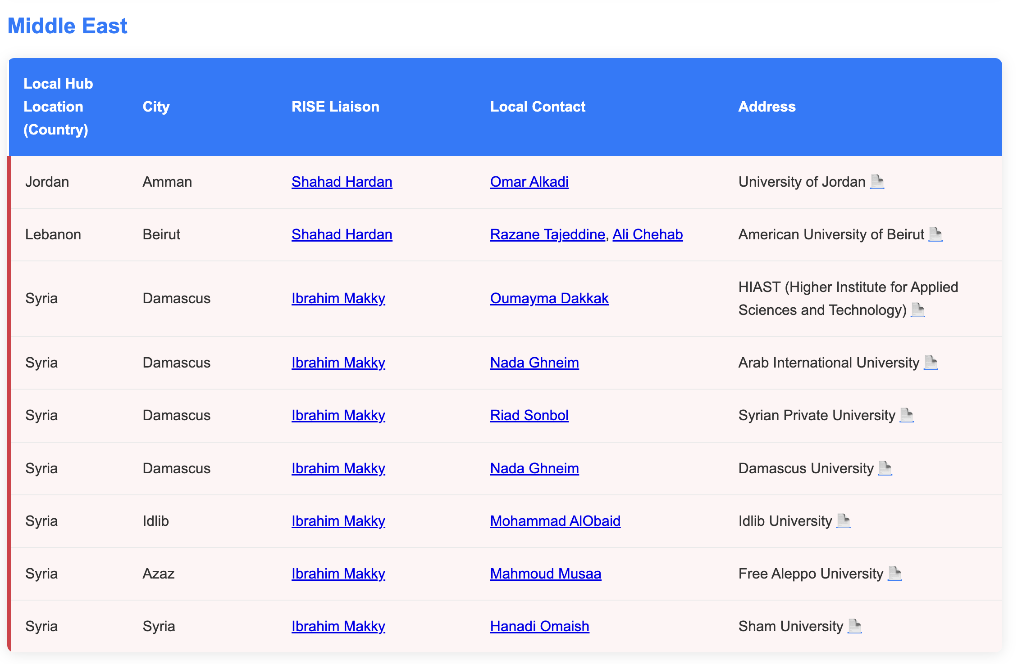
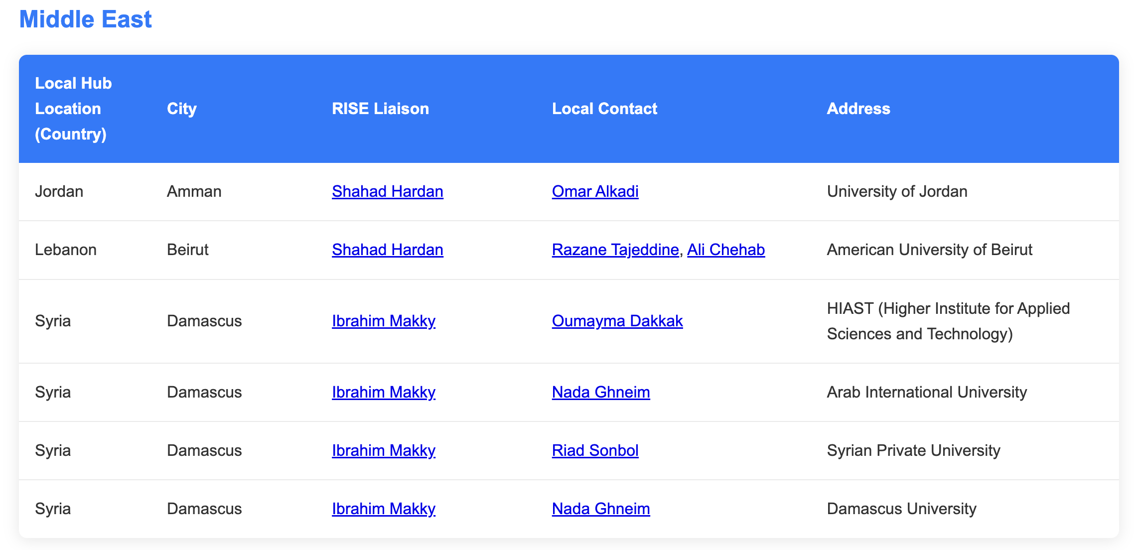
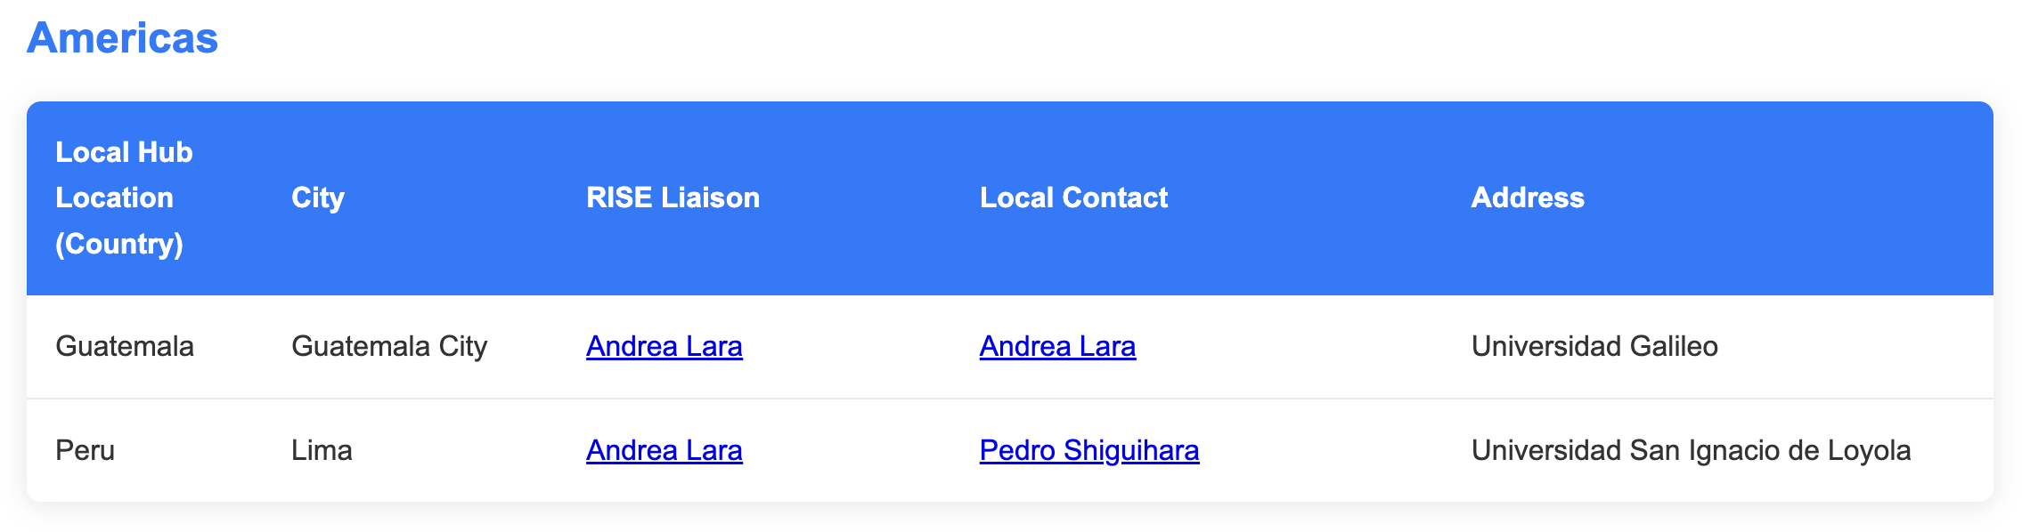

Slide 24
Mentorship Program
The Summer School will offer the possibility to participate in a mentorship program. A selected group of students will be paired with a mentor for one year with the intention of writing a paper for MICCAI 2026.
What you’ll gain:
🎯 Personalized guidance on project design, writing, and publishing
🤝 Regular one-on-one sessions with your mentor
📄 Hands-on support to develop & submit your MICCAI 2026 paper
Selection Criteria
The mentorship programme will be offered only to students who have never attended MICCAI before and are looking to attend MICCAI 2026. To be eligible, you must work on a challenge task for approximately one month and submit the results to the challenge organizers.
Key dates:
📅 Application deadline: 18 July, 2025
⏳ Mentorship period: 1 September 2025 – 1 October 2026
https://summer.rise-miccai.org/

Slide 25
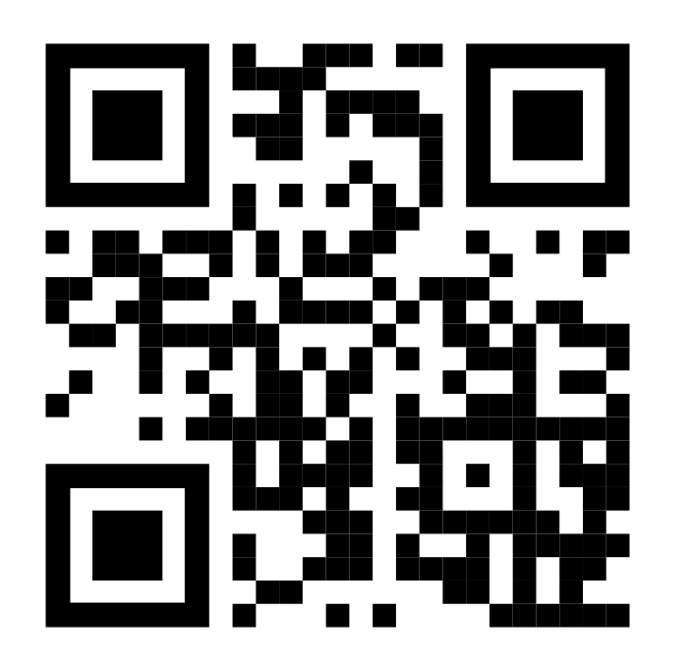
Thank you!
Join us now! Become a RISE Ambassador!
We extend our sincere gratitude to the following individuals and groups for their invaluable contributions:
RISE Board Members
MICCAI 2026 Local Committee
Local Hub Organizers
MICCAI Society (and specifically Diana Cunningham for her zoom support)
Speakers
https://rise-miccai.org

